Slide 1
Eyewitness testimony
Kristy Horton
kristy.horton@beds.ac.uk

Slide 2
Today…
Leading questions.
The cognitive interview.
Weapon focus.
Jury decision making.

Slide 3
Interviewing.

Slide 4
To get you started…
https://www.youtube.com/watch?v=Rg5bBJQOL74&ab_channel=MrMartinExplains
How fast were the cars going when they bumped into each other?
Type a number in mph in the chat box.
https://www.youtube.com/watch?v=fWv6o5tv1VQ&ab_channel=S3V4NS
Did you see the guy in the black baseball cap?
Just type yes or no into the chat box.
https://www.youtube.com/watch?v=Rg5bBJQOL74&ab_channel=MrMartinExplains
How fast were these cars going when they smashed into each other?
Type a number in mph in the chat box.

Slide 5
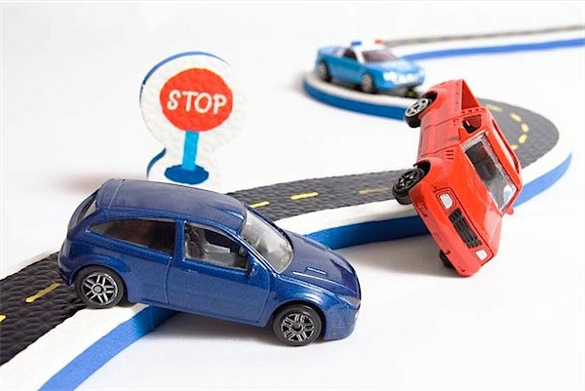
Leading questions.
Loftus and Palmer (1974)- Reconstruction of auto mobile destruction: An example of the interaction between language and memory. ​
Bumped Vs smashed.
Bumped= slower
Smashed= faster
Subtle leading question!
Oh… and no baseball cap!

Slide 6
Police interviewing
UK vs US interviewing
PEACE vs interrogation- Reid technique
The cognitive interview.
Some examples of each…

Slide 7
PEACE- UK
What do you think happens at each stage?
Planning and preparation
Engage and explain
Account
Close
Evaluation

Slide 8
The Reid Technique- US
What do you think happens at each stage?
Direct confrontation
Themes which justify crime
Minimize denials
Move to acknowledgement of crime
Reinforce sincerity
Offer alternative explanations for crime
Suspect chooses scenario in which crime committed
Lead suspect to confess
Get written/ recorded evidence of confession

Slide 9
The cognitive interview
What do you think happens at each stage?
Mental reinstatement of context
In depth reporting
Viewing event from different perspectives
Describe event in different orders
Additional details

Slide 10
Interview techniques- evaluation
PEACE
Reid
Cognitive interview
A volunteer for an example of each!
What is good and bad about my interviewing technique in each example?
Which technique is likely to produce the most reliable/ accurate information?

Slide 11
Crime scene details.

Slide 12
Crime scene details
Tell me the details you remember about the following scenes.
Why did these details stick out in your head?

Slide 13
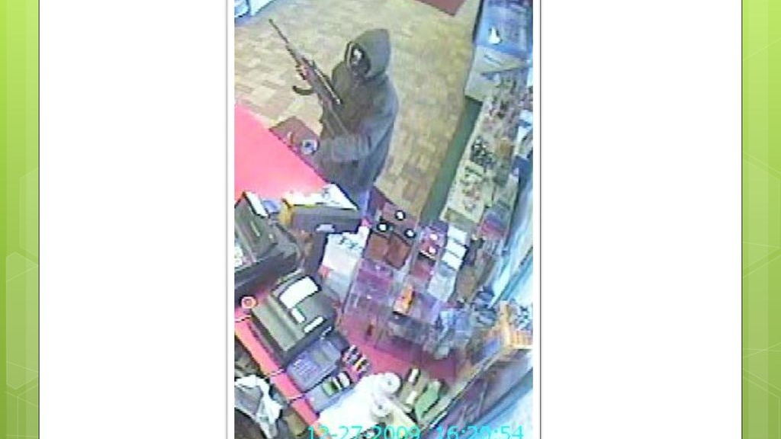

Slide 15
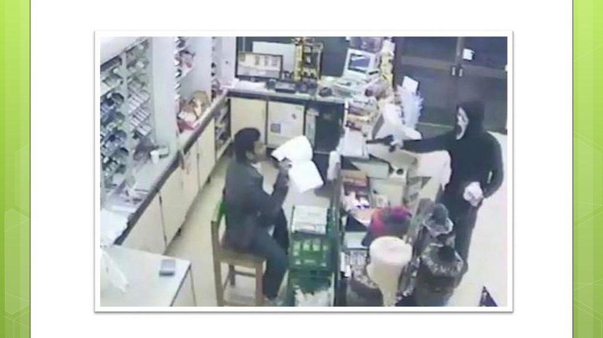

Slide 19
Weapon Focus
What do you remember about the photos?
Why do you think you remember these details?
How did the photos make you feel?
How might this impact your testimony if you were witness to a crime?

Slide 20
Weapon Focus
What is anxiety?
What does anxiety feel like?
Anxiety= physiological arousal.
What does physiological arousal feel like?

Slide 21
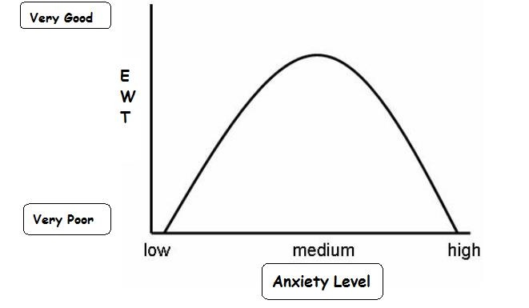
Weapon Focus
Central details (weapon) remembered
Peripheral details (face) ignored
Focus on weapon as source of fear
Weapon= threat= anxiety
Anxiety improves recall
Anxiety hinders recall

Slide 22
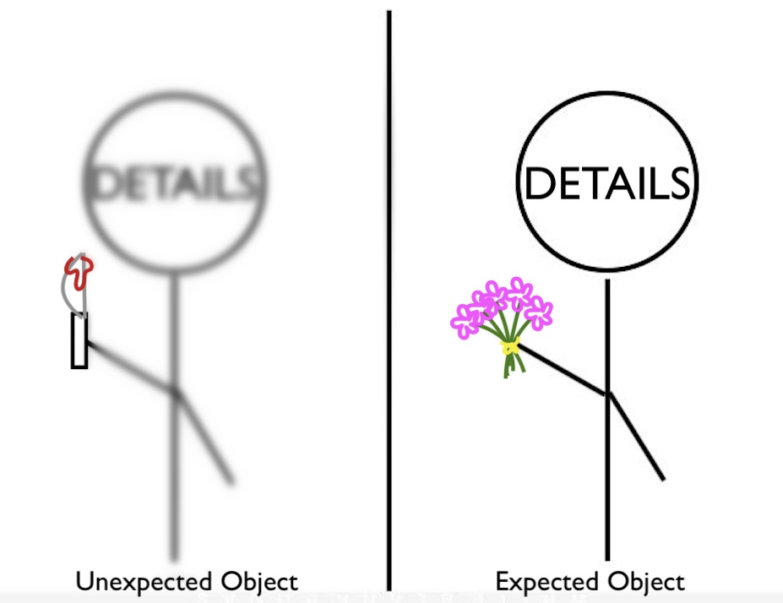
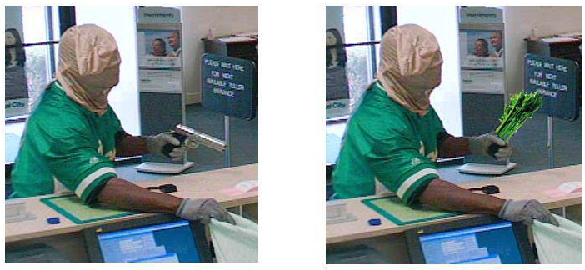
Could just be novelty/ surprise

Slide 23
Jury decision making.

Slide 24
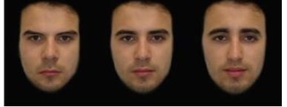
Which face looks most trustworthy?

Slide 25
Trustworthiness
The one on the right? why?/ why not?
Less likely to be convicted + shorter sentences!
Trustworthy faces look more feminine? Less threatening?
Pick trustworthy face when looking for potential mate= more attractive?

Slide 26
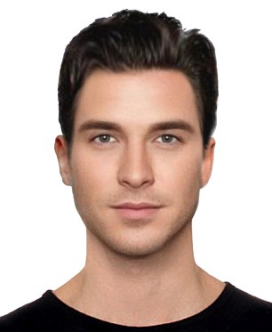
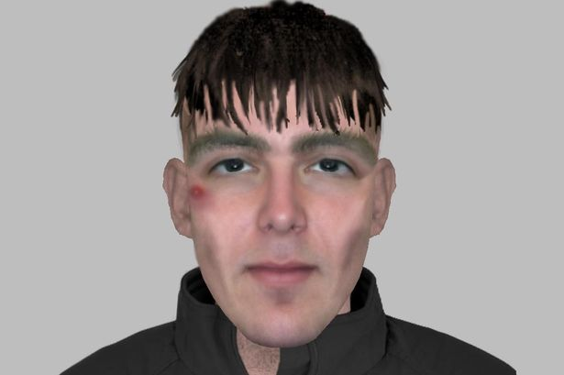
Which man is more likely to commit a crime?

Slide 27
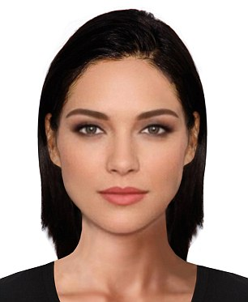
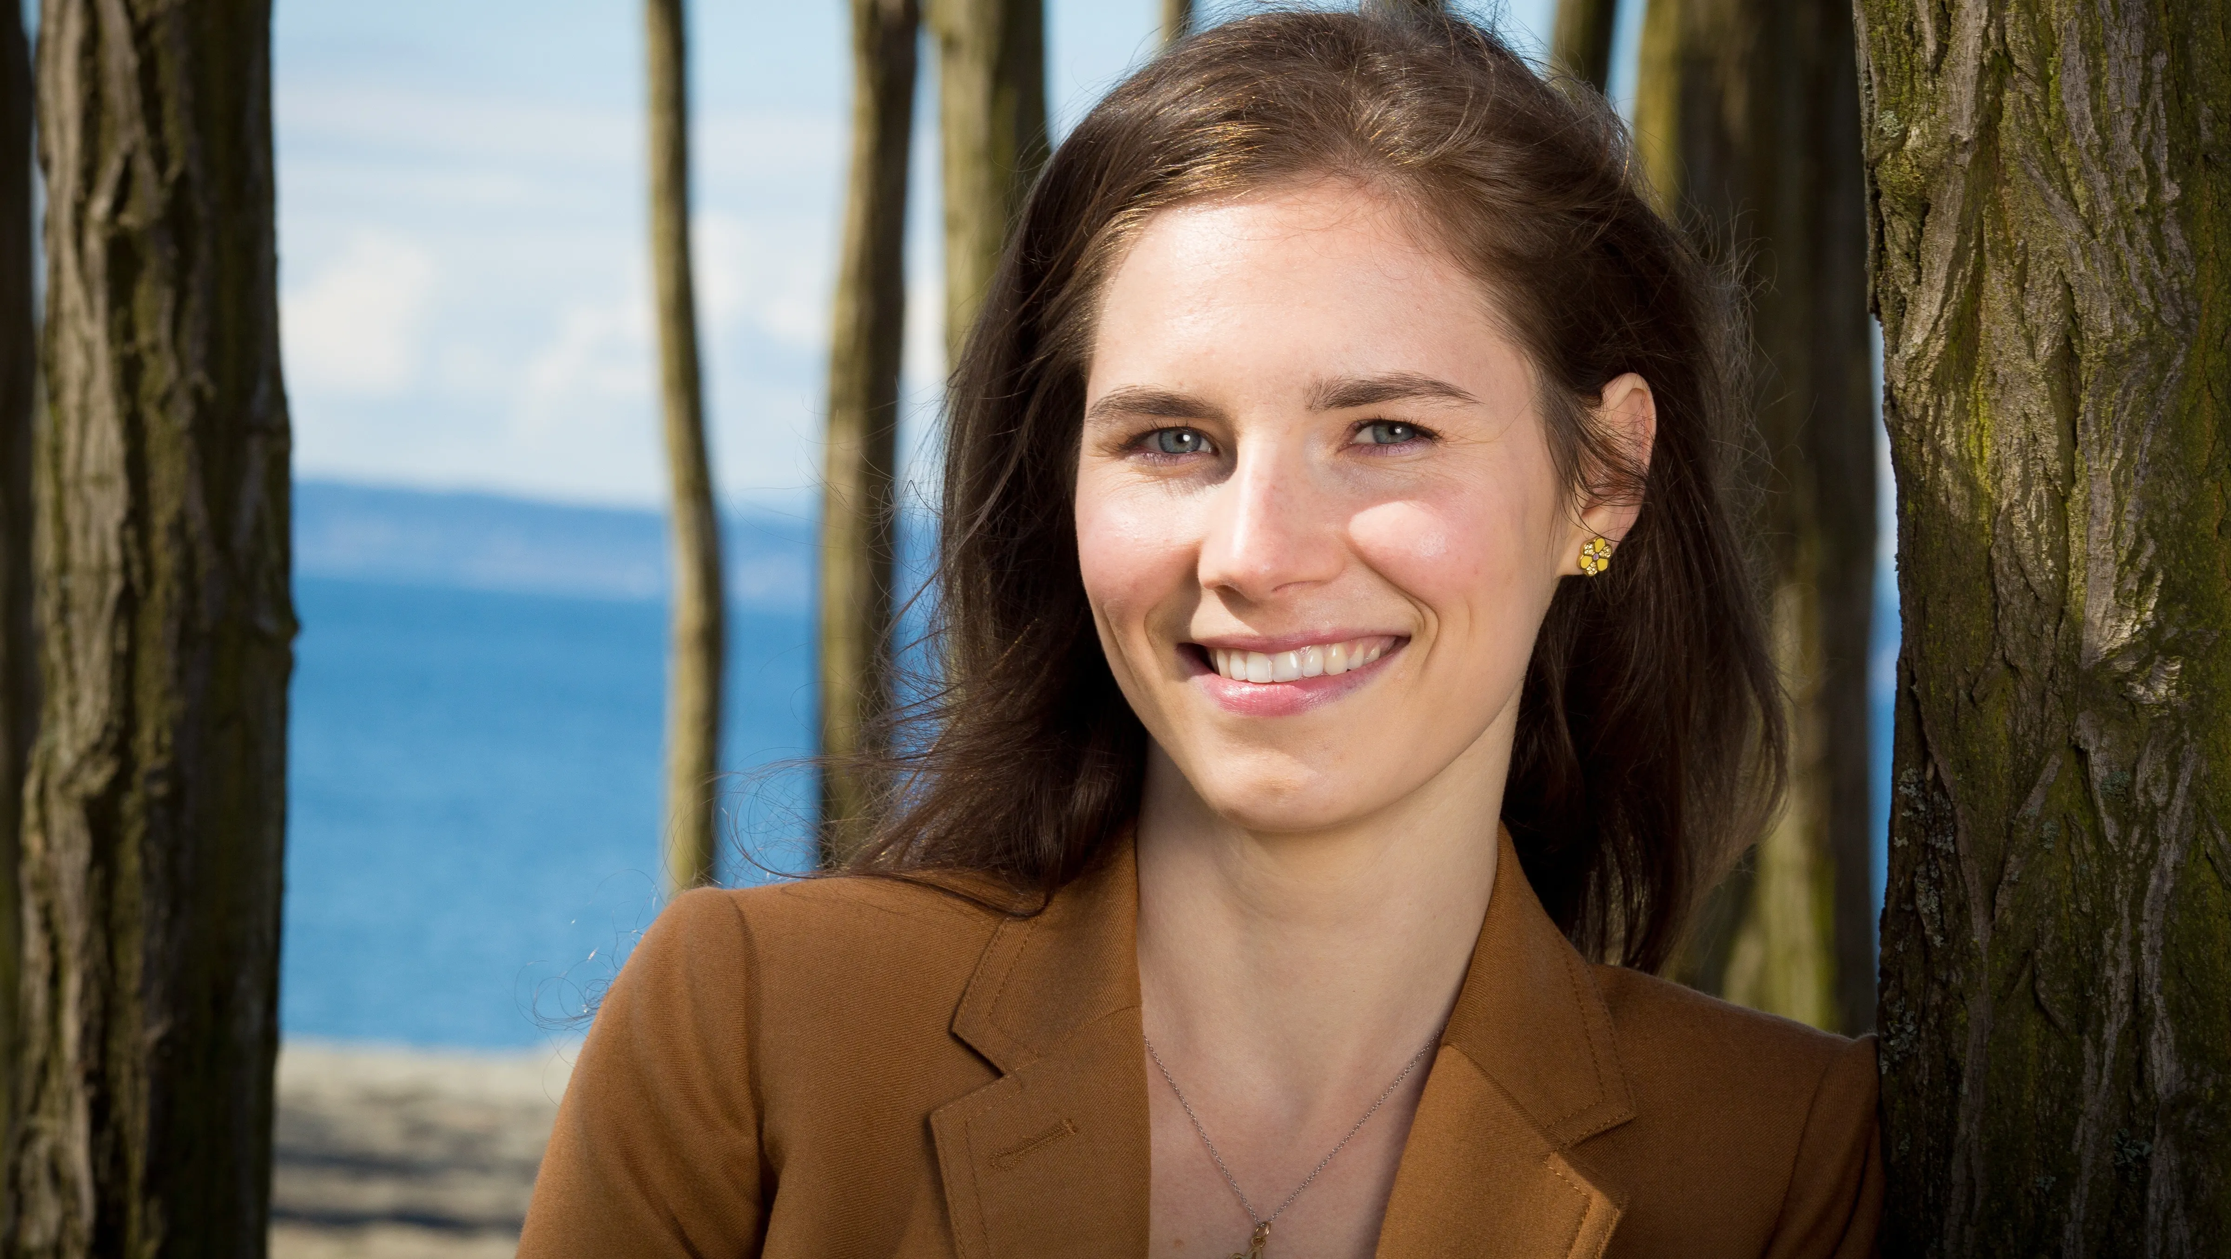
Attractiveness and offending
According to juries:
For men:
More attractive= less likely found guilty + shorter sentences (22m)
For women:
Depends on crime.
Attractive helps to extent.
If sex related crime not helpful.

Slide 28
Questions?

Slide 29
Some resources you might like
Ministry of Justice: Achieving best evidence in criminal proceedings- https://www.cps.gov.uk/sites/default/files/documents/legal_guidance/best_evidence_in_criminal_proceedings.pdf
College of Policing: Investigative interviewing- https://www.app.college.police.uk/app-content/investigations/investigative-interviewing/
The Reid technique- https://www.sciencedirect.com/topics/psychology/reid-technique
Trustworthy faces- https://www.psychologytoday.com/gb/blog/talking-apes/202008/are-trustworthy-faces-more-attractive
Attractiveness and trustworthiness in verdicts- https://www.ncbi.nlm.nih.gov/pmc/articles/PMC6775219/

