Slide 1
Self-Confidence Workshop

Slide 2
Help us to help you!
Please complete the survey – it takes just 2 minutes!
It will help us support you more in the future!
Help us to help you
Click here for survey
Notes:
Help us to help you.
Please complete the survey – it takes just 2 minutes!
It will help us support you more in the future!

Slide 3
Content of the session
What is self-confidence?
How do you think about challenges?
How can I build self-confidence?

Slide 4
What is self-confidence?
How would you define it?
Notes:
Class discussion to agree on definintion

Slide 5
What is self-confidence? What would your definition be? Does it compare to any of these?
The attribute of knowing oneself.
Being capable of evaluating personal strengths and weaknesses.
Being able to positively represent your abilities and experiences with confidence.
Notes:
Self-confidence enables you to influence and inspire confidence in others.

Slide 6
Improving your confidence Your ARE good enough!
“Decades of research support the notion that believing in your ability to do something enhances your ability to do it.”
(Briggs, 2014)
Notes:
Get a willing volunteer to read the quote out load
Briggs, S. (2014). Why self-esteem hurts learning but self-confidence does the opposite. Neuropsychology & Education Services for Children & Adolescents. http://www.nesca-news.com/2014/07/why-self-esteem-hurts-learning-but-self.html
https://www.riseselfesteem.com/get-started-with-rise-self-esteem/

Slide 7
Activity What are you most proud of?
Think about something that you have done that you are proud of and complete the sentence.
‘This is the achievement
I am most proud of because...
Did it help you develop your self-confidence?
Notes:
Write this down
Explain to the person sitting next to you why you are so proud of this
Lets start on a positive note & think of time when you felt most confident? What did you achieve through this confidence
How did this make you feel?
"decades of research support the notion that beleiving in your ability to do something enhances your ability to do it." from Briggs, 2014.
http://clipartmag.com/star-vector-image

Slide 8
How do you think about challenges?
Mindset matters

Slide 9
Problem or a challenge? It’s about your mindset and how you approach something.
Problem:
Something to avoid
Challenge:
An opportunity to make the most of
Notes:
Ask the students to discuss what they think about challenges – are they a problem or do they see it as an opportunity?
Why is it a problem?
Why do you see it as an opportunity?
Why do we worry? Having a go? Failure? Rejection?
https://www.iconfinder.com/icons/2875504/financial_money_bill_problem_debt_issue_icon
http://www.ssnapp.info/hospitality-borgata/challenge-icon-stride/

Slide 10
What it takes to stay positive
Get support
Think & Act Positive
Stay Focused
Gaining inspiration from others can help develop new confidence.
Tough Times
Source: Barclays Life Skills
Notes:
There’s no such thing as a negative experience – just the opportunity to grow. R. Sharma
Always try to find a positive in a negative
Life doesn’t always go to plan – but that’s OK.

Slide 11
How can I build self-confidence?
You’ve got to help yourself!

Slide 12
Ways to be positive There are things you can do increase your self-confidence
Be resilient
Be optimistic
Be prepared
Try something new
Notes:
Be resilient - bouncing back from difficult experiences
Be optimistic – show positive thinking and the concept of the glass is half full rather than half empty
Be prepared - research & prepare for situations new and old
Be a risk taker – don’t be afraid to try something new.

Slide 13
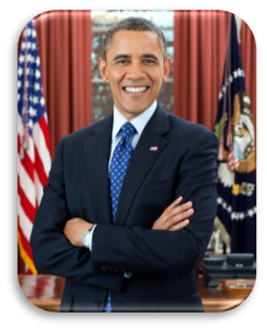
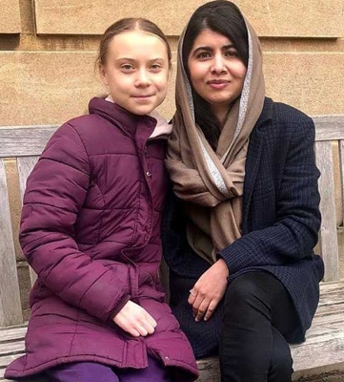
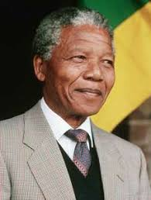
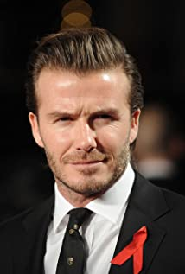
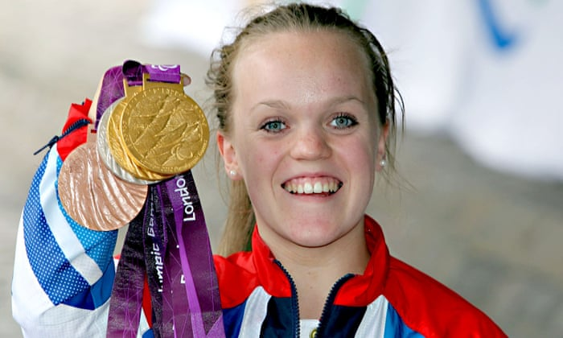
Activity Who inspires you?
Think of someone you find inspiring…
How do they inspire you?
How can that help you be more confident?
Notes:
Group / class discussion about who inspires students and why
Images:
Barak Obama, 44th President of the United States. Image source: https://en.wikipedia.org/wiki/Barack_Obama
Greta Thunberg (environmental campaigner and activist) and Malala Yousafzai (Noble Peace Prize winner) - Malala Fund invests in education programmes to help girls go to school and reach their full potential. Image source: https://www.ndtv.com/world-news/nobel-peace-prize-winner-malala-yousafzai-meets-teen-climate-activist-greta-thunberg-at-university-o-2185697
Nelson Mandela – anti-apartheid activist, first black president of South Africa, philanthropist. Image source: http://austintalks.org/2013/12/west-side-residents-celebrate-nelson-mandela/
Ellie Simmonds – British Paralympian swimmer. image source: https://www.theguardian.com/sport/2020/jan/11/ellie-simmonds-swimming-rio-tokyo-paralympics-interview-donald-mcrae#img-3
David Beckham – international footballer and global brand icon. Image source: https://www.imdb.com/name/nm0065743/mediaviewer/rm3054752512?ref_=nm_ov_ph
Zendaya – youngest winner of Emmy for Actress in a Drama Series (2020). Image source: https://en.wikipedia.org/wiki/Zendaya#/media/File:Zendaya_by_Gage_Skidmore.jpg

Slide 14
More information or support? Here are some organisations that might be able to help!
Notes:
Mental health charities, groups and services
Mental Health Foundation
020 7803 1101
Improving the lives of those with mental health problems or learning difficulties.
Together
020 7780 7300
Supports people through mental health services.
The Centre for Mental Health
020 7827 8300
Working to improve the quality of life for people with mental health problems.
Depression Alliance
0845 123 2320
Provides information and support to those who are affected by depression via publications, supporter services and a network of self-help groups.
BACP Find a Therapist Directory
01455 883300
Through the British Association for Counselling & Psychotherapy (BACP) you can find out more about counselling services in your area.
PANDAS Foundation
0843 28 98 401 (every day from 9am-8pm)
PANDAS Foundation vision is to support every individual with pre (antenatal), postnatal depression or postnatal psychosis in England, Wales and Scotland. We campaign to raise awareness and remove the stigma. We provide our PANDAS Help Line, Support Groups offer online advice to all and much more.
General advice and support
Citizens Advice
Gives free confidential information and advice to help people sort out their money, legal, consumer and other problems.
Support for children and young people
Young Minds
020 7336 8445
Provides information and advice for anyone with concerns about the mental health of a child or young person.
Childline
0800 1111
Free, national helpline for children and young people in trouble or danger.
Nightline
Listening, support and information service run by students for students.
Other places you could go for support
Age Concern
0800 009966
Infoline on issues relating to older people.
Lesbian and Gay Switchboard
020 7837 7324
Provides information, support and referral services.
Refugee Council
020 7346 6700
The UK’s largest organisation working with refugees and asylum seekers.
Relate
0300 100 1234
Offers advice, relationship counselling, sex therapy, workshops, mediation, consultations and support.
Education Support Partnership
08000 562 561
A 24/7 telephone support line which gives teachers access to professional coaches and counsellors 365 days a year. The network also campaigns for change within schools and education policy in order to improve the wellbeing, mental and physical health of teachers.
Anxiety UK
08444 775 774
Works to relieve and support those living with anxiety disorders by providing information, support and understanding via an extensive range of services, including 1:1 therapy.
Carers organisations
Carers UK
Carers UK is the voice of carers. It improves their lives by providing information, advice, support and by campaigning for change.

Slide 15
Don’t forget to complete our survey!
Help us to help you!
Click here for survey
aspire-higher.co.uk/
@AspireHigherNet
Notes:
Help us to help you.
Please complete the survey.

Slide 16
Self-Confidence Workshop

