Slide 1
Routes into STEM
Notes:
Today I will talk about Routes into STEM

Slide 2
Content of the session
What is STEM?
What careers are available?
How to get into STEM?
Notes:
In this session I will cover, what is STEM, What Careers are available and How to get into STEM. This should give you a good insight into STEM and routes in.

Slide 3
What is STEM?
How does this relate to the world around us?
Notes:
Do you know what STEM stands for? How does this relate to the world around us? Is STEM important for our day to day lives?

Slide 4
Notes:
STEM stands for Science, Technology, Engineering and Maths. If you are interested in how the world works and solving problems you may be interested in a STEM related job or career.
Problem solving is used by STEM professionals. They create new things, items that exist and figure out how to make them better for the world we live in.

Slide 5
How does Science, Technology, Engineering and Maths shape our lives?
List the following on a piece or paper and share with the person next to you.
In this room can you find…
Something that you wish you had invented
Something that can send messages between places
Something that makes your life easier
Something that could help save someone’s life
Something that you can fit in your pocket
How many objects have an internal component?
How many people do you think had to work to create them?
Notes:
Science, Technology, Engineering and Maths shape our lives in many ways. Most of the things we use in our day to day lives have been created by a scientist, engineer or someone who uses technology and maths in their work. Look around the room you are in and think of what objects relate to STEM. Write a list on a piece of paper and share with the person next to you. Use these questions to consider how STEM is used in your room.

Slide 6
STEM relates to many things we use in our daily lives
Here are some examples:
products
buildings
electronics
Notes:
Many of the products you use have been created by scientists and engineers. These include toys, kitchen gadgets, appliances and much more. The buildings we live, learn and work in are overseen by engineers that make sure they are designed, safe and fit for use. Mathematicians and people who work in computing create apps and web content for our computers and phones. These are just some of the examples of how STEM touches our lives.

Slide 7
What are STEM careers?
Notes:
What are STEM careers? STEM careers are varied. There may be careers that surprise you as you didn’t realise they were STEM.

Slide 8
Notes:
What skills you have and what you study now and in the future can lead you into a STEM related job. Using computing, digital, problem solving and maths skills in your daily lives can be beneficial to getting into STEM jobs. I will talk more about the pathways into STEM later in this presentation. There are many benefits to working in STEM.

Slide 9
Opportunities in STEM
https://www.youtube.com/watch?v=3bnMBhO0LnU
Notes:
Click on the link to watch this video produced by STEM Learning to see the wide range of jobs related to STEM.

Slide 10
Top STEM Careers by Pay
Civil Engineering - £44,851
Engineering - £42,837
Computer Science - £41,950
Mechanical Engineering - £39,106
Mathematics - £39,019
Notes:
You should consider many aspects of a career before deciding on which to go into. You may consider how interesting the job is, opportunities for promotion and what you are good at. Money isn’t the only factor. However, if you are interested in STEM, you will be happy to know these are well paid careers. Here are some examples of STEM careers and the average pay. There are many opportunities to increase this pay with experience.

Slide 11
Careers in STEM
Notes:
Here are some careers using computers and mathematics. A Web Developer may be responsible for designing websites and project managing. They could also work in a large team with web designers, project managers and animators for designing websites and apps. Most would have a degree in computer science. Their starting salaries can range from £25,000 and £37,000. The need for Security Analysts is growing. Governments and companies need to make sure their data is secure. These jobs pay well with starting salaries at £40,000 in some firms.

Slide 12
Notes:
Architects and Engineers are responsible for building and creating so many parts of our cities, medicines and technology we use. Look at the key words describing their roles and their salaries.

Slide 13
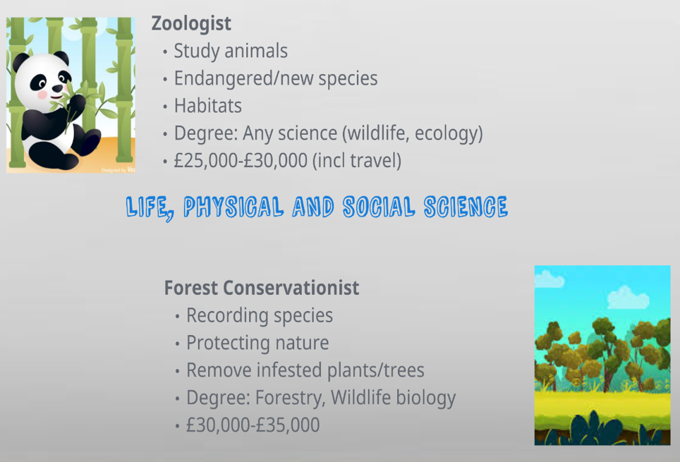
Notes:
Life, physical and social science are also part of STEM. Zoologists and Forest Conservationist are just two of the jobs available.

Slide 14
How to get into STEM?
Different routes to suit you.
Notes:
Now we should look at the courses you may need to get into STEM careers.

Slide 15
Qualification routes into STEM
GCSEs
Maths
Sciences
Technology
A-levels
Maths
Engineering
Degree
Maths
Engineering
Sciences
Computing
BTEC
T-levels apprenticeship
Sciences
Engineering
Notes:
If you are considering a career in STEM you need to study specific subjects. You study Maths and Sciences as part of your GCSEs. To continue into a job in STEM you may want to consider studying a science subject and Maths at A-level. A few sixth forms also offer engineering at A-level. The new T-levels and level 3 BTEC diplomas and apprenticeships also offer engineering as a subject. There are routes into STEM careers with or without a degree. There are some advantages of studying a degree for professional careers.

Slide 16
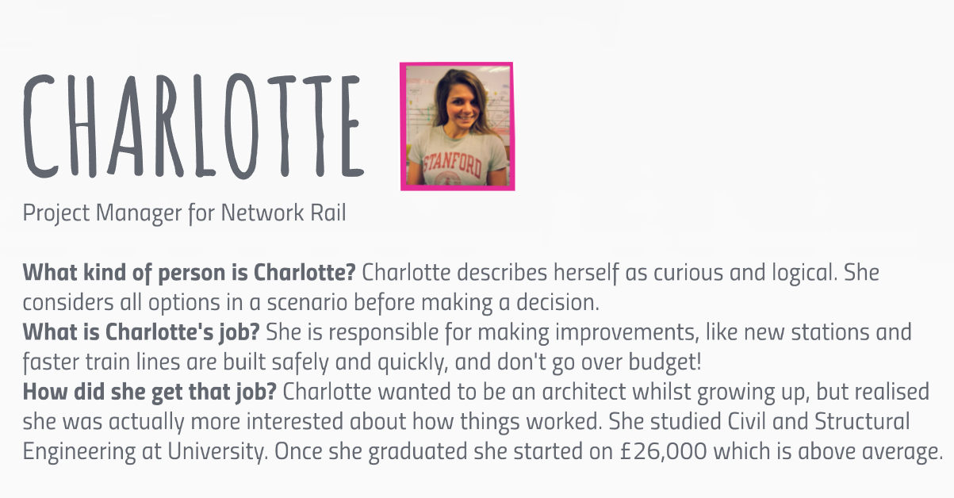
Notes:
Charlotte is an example of someone who studied a degree at university to get into an engineering career. Look at Charlotte’s story to find out more about the skills she has, her job and how she got into her career. She even says what she started earning as a salary.

Slide 17
Notes:
Gemma got into a career in engineering without a degree. She started with an apprenticeship in engineering. You can decide the route you want to choose. Look at the details above to find out more about what Gemma does, her skills and her route in. She also says how much she earns.

Slide 18
Activity 2 – Match the degree
Look at the next slide.
In pairs or on your own match the degree with the career.
Check on https://nationalcareers.service.gov.uk/explore-careers for the answers.
Notes:
On the next slide there are many different careers listed in blue writing. The degree subjects are in red. Work in pairs or on your own if you are at home. Think about what degrees you need to get into the careers. Then check your answers by looking on a careers website. The National Careers Service is a good place to start. You can type in the name of the career on ‘explore careers’. It will give you information on what qualifications you need to get into different careers. If the career isn’t listed, then look on another careers websites. There are many to choose from such as careerpilot.org.uk.

Slide 19
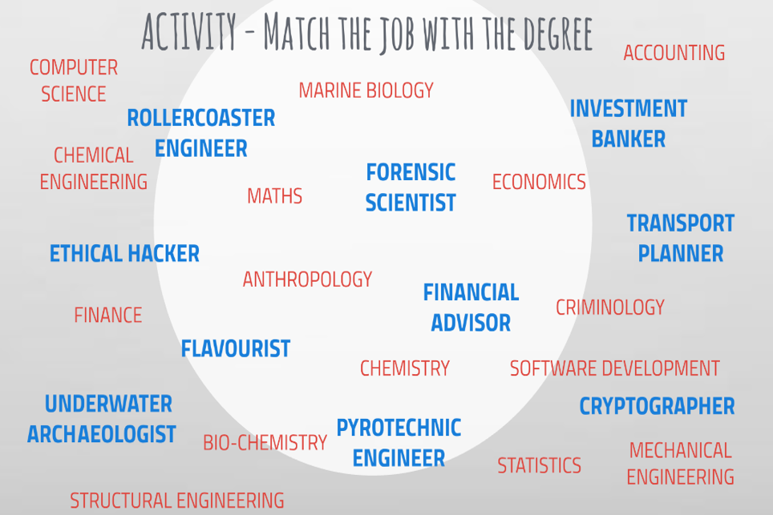
Notes:
Remember the careers are listed in blue. After matching the degrees and careers you may be surprised by some of the answers. Sometimes there are more than one route in. Here are the answers:
Flavourist – A food science or biochemistry degree is usually required
Rollercoaster engineers usually have a structural engineering degree
Underwater archaeologist – There are many degrees you can choose for this career such as -geology, geophysics, oceanography and other earth sciences as well as chemistry and biology.
Pyrotechnic engineer – you would normally need a chemical engineering degree
Cryptographer- usually require a computer science degree
Forensic scientist – Several degrees are useful to enter this career such as chemistry, biochemistry, life sciences, applied sciences, medical sciences or forensic science.
Transport planner – A geography, economics, civil engineering or environmental studies degree
Investment Banker – There are many ways into banking, but an economics, maths, business studies, accountancy or finance degree is an advantage.
Financial Advisor – There are many ways into this career, but many working in this area have an accounting, business management or finance degree.
Ethical Hacker – Most people working in this career have a computer science, cyber security or maths degree.
Were you surprised by some of the answers? As you can see there are usually more than one way into a STEM career.

Slide 20
Thank you for listening.
Please click here to tell us what you think
aspire-higher.co.uk
Notes:
Thank you for listening. Please visit our website for more useful links and resources. If you have a question you can contact us via our Twitter handle. Please click on ‘Tell us what you think’ to answer a short survey. The information you give will help us to support students and develop more resources.

