Slide 1
Success with Stress: Focus on the positive using affirmations
Notes:
Welcome.
Introduce yourself – Smile!
Explain Aspire higher are University of Northampton, University of Bedford and University of Hertfordshire working together to increase participation in higher education.

Slide 2
Want this resource in another format?
If you require this presentation with an audio voiceover and subtitles, click the link below.
Click Here for Positivity and Affirmation Presentation with Audio and Subtitles
Help us to help you
Use the button to adjust subtitle options

Slide 3
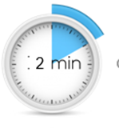
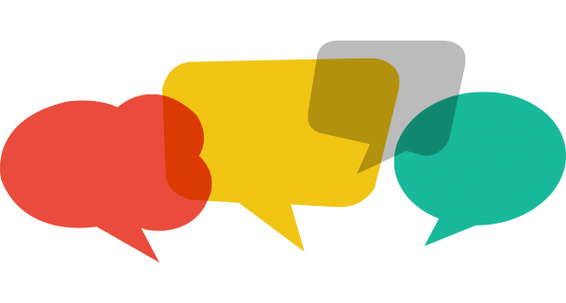
Help us to help you!
Please complete the survey – it takes just 2 minutes!
It will help us support you more in the future!
Help us to help you
Click here for survey
Notes:
Help us to help you.
Please complete the survey – it takes just 2 minutes
It will help us support you more in the future
Picture source https://www.freepngimg.com/internet/feedback

Slide 4
Content of the session
What are Stress and Resilience?
How can I focus on the positive using affirmations?
Notes:
This video is going to go over the instructions for the Focus on the Positive and using Affirmations techniques in the workshop. You can stop and start the video as you need to while you’re practising.

Slide 5
What are Stress and Resilience?
Stress
NOUN
a state of mental or emotional strain or tension resulting from adverse or demanding circumstances.
Resilience
NOUN
the capacity to recover quickly from difficulties; toughness.
Notes:
The first of our big questions are about what stress and resilience are and how to recognise when you need to use one of your stress-busting techniques to help yourself.

Slide 6
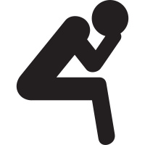
What is Stress?
Stress is a normal response from your body when it feels threatened.
Fight or flight response
Feelings of fear, anxiety, anger
Notes:
Stress is a normal response we feel when we feel threatened by something. It triggers our fight or flight response. Basically, its evolved with humans to help us stay alive by running away from that dangerous animal or by fighting our way out when we’re cornered by warriors from the next tribe over. Its still useful now too – in small doses. All the healthy living tips you’ve been hearing throughout the Coronavirus Pandemic are part of dealing with the stressful situation and so is our resilience.
Another example is when you go into the exam room, take your driving test or be faced with a new situation, you might feel nervous. Again, that’s totally normal – your body has recognised a potentially stressful situation and flooded your body with a hormone called adrenalin as that’s the automatic reaction. You can’t stop it happening, but you can take steps to bring down your stress levels and feel less nervous or anxious. That’s where resilience comes in.
Image Source: https://static.thenounproject.com/png/1760-200.png

Slide 7
What is Resilience?
Resilience is the mental processes we all have to deal with challenging and difficult situations.
You have it and you can work on it so you have more
Notes:
We all have resilience – it the mental processes that helps us cope when things are a bit challenging and bounce back after we have gone through something difficult. It’s something we can develop so we have a bigger reserve of mental energy to help us feel better when we feel stressed or are having a hard time. So the aim of this video series is introduce you to some ideas that you can use to try and help you manage your feelings in stressful situations and build your resilience up even more.
There are a few things that really help with our resilience–
being positive. Using positive language really does make a difference to how you think and feel if you keep doing it.
Being able to regulate our emotions. Recognising what we’re feeling and why and recognising that feelings aren’t permanent and they pass is important to helping us cope with negative feelings.
Being able to learn when we don’t get things right. Being able to learn from getting things wrong is an important form of feedback and being able to use it really helps us see things in a different way.
Resilience is something we can develop so we have a bigger reserve of mental energy to help us feel better when we feel stressed or are having a hard time. So what I want do here is introduce you to some ideas that you can use to try and help you manage day-to-day stress and build your resilience up even more.
The techniques you’ll learn here will, with a bit of practise, become part of your resilience toolkit and you can use them to help you to reclaim a calm and focussed state of mind so you can do your best to cope with what ever stressful situation you come up against. They are good for helping you now, during lockdown and the gradual return to life outside the home coming up over the rest of this year but they’re also useful for any stressful situation you find yourself needing a bit of calm in – exams, driving tests, job interviews, meeting your partner’s parents…..
Image Source: https://d30y9cdsu7xlg0.cloudfront.net/png/147367-200.png

Slide 8
How does this connect to resilience?
Stressful situations need resilience to deal with them
Finding ways to deal with negative emotions is building your resilience
These techniques are extra tools in your Resilience Toolkit
Notes:
As we’ve said, resilience is your ability to deal with and bounce back from challenging situations. Feeling stressed can be very challenging so developing skills that you can use in the moment is as important to resilience as being able to deal with challenges or difficult situations that might be lower stress. So the more tools that work for you that you have at your fingertips, and the more practised you are in using them, the better the result is for your mental wellbeing.
Image Source: https://angelairvin.files.wordpress.com/2014/12/black-icon-transparent-background.png?w=1387&h=1519

Slide 9
How can I focus on the positive using affirmations?
Be positive – retrain your brain!
Notes:
You can build new tools into your resilience toolkit all your life and the more you practise them when you don’t need them, the more useful they will be when you do need them. Try out each of the techniques we’re looking at today and see which ones work best for you. You don’t have to use them all – you might find that one or two work better than the others for you. But you can only figure this out by trying them all.

Slide 10
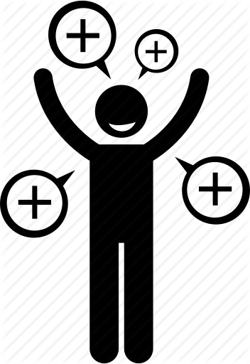
Focus on the positive
Sometimes it might be a big thing, sometimes just a little one that made you smile for a moment.
At the end of the day, write a list of positive things that happened in the day.
When you need a boost, you can go back to the list and it can help you remember some of the good things that have happened.
Notes:
We said in the first video that being positive is a big part of resilience. It might feel difficult to find positive things just now, but there are lots of positive things that are still happening all around. Sometimes it’s a big thing, like someone doing something special for you; sometimes it might be something little like your pet made you smile.
At the end of the day, write down the positive things that happened today – try for at least 5 every day. Everything matters, no matter how small. Write a couple of sentences about each one. Very quickly you’ll build up a list of positive things that you can go back to look at when you are feeling a bit stressed and need to smile.
Image Source: https://cdn1.iconfinder.com/data/icons/being-a-happy-person/309/happy-person-005-512.png

Slide 11
Affirmations
Good for giving yourself a boost of self-confidence
Works by retraining your brain to focus on the positive
I enjoy the subject I’m studying
I feel relaxed and confident during tests and exams
Taking exams and proving my knowledge is fun
I love being challenged by interesting subjects
Notes:
You’ve heard people say that if you say something often enough, you start to believe it? Well, its true and that’s what affirmations are about.
An affirmation is a positive statement that you tell yourself to give yourself a boost, encourage yourself, increase your confidence and demonstrate to yourself that you are in charge. You could try using one of the ones on the slide or choose one of your own.
The ones on the slide give a mix of affirmations related to studying or being in challenging situations but you can make up your own to help you deal with any situation or feeling. It can be as simple as you like – even something like ‘I am going to have a good day’ will have a positive effect on you.
Keep affirmations in the present tense, only use positive language and repeat them to yourself as much as you need to until it starts having the effect you want – it may take a little while but keep going with it until you start to believe it. Then you can use it when you need it to help keep you in control.
Image Source: https://www.affirmationpod.com/wp-content/uploads/2016/10/Affirmation-Pod-Facebook-Like-Page-Thumbs-Up.png

Slide 12
Don’t forget to complete our survey!
Help us to help you!
Click Here for Survey
aspire-higher.co.uk/
@AspireHigherNet
Notes:
Help us to help you.
Please complete the survey.
Photo source https://www.eurodrying2019.com/uk/page.asp?PID=97
Company logo: Twitter

Slide 13
Success with Stress: Focus on the positive using affirmations
Notes:
Welcome.
Introduce yourself – Smile!
Explain Aspire higher are University of Northampton, University of Bedford and University of Hertfordshire working together to increase participation in higher education.

