Slide 1
Success with Stress: Distraction and Relaxation
Notes:
Welcome.
Introduce yourself – Smile!
Explain Aspire higher are University of Northampton, University of Bedford and University of Hertfordshire working together to increase participation in higher education.

Slide 2
Want this resource in another format?
If you require this presentation with an audio voiceover and subtitles, click the link below.
Click Here for Distraction and Relaxation Presentation with Audio and Subtitles
Help us to help you
Use the button to adjust subtitle options

Slide 3
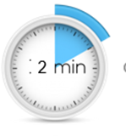
Help us to help you!
Please complete the survey – it takes just 2 minutes!
It will help us support you more in the future!
Help us to help you
Click here for survey
Notes:
Help us to help you.
Please complete the survey – it takes just 2 minutes
It will help us support you more in the future
Picture source https://www.freepngimg.com/internet/feedback

Slide 4
Content of the session
What are stress and resilience?
What distraction and relaxation techniques could I try?
Notes:
This video is going to go over the instructions for the breathing techniques in the workshop. You can stop and start the video as you need to while you’re practising.

Slide 5
What are Stress and Resilience?
Stress
NOUN
a state of mental or emotional strain or tension resulting from adverse or demanding circumstances.
Resilience
NOUN
the capacity to recover quickly from difficulties; toughness.
Notes:
The first of our big questions are about what stress and resilience are and how to recognise when you need to use one of your stress-busting techniques to help yourself.

Slide 6
What is Stress?
Stress is a normal response from your body when it feels threatened.
Fight or flight response
Feelings of fear, anxiety, anger
Notes:
Remember that stress is a normal response to something your body thinks is threatening. It can be helpful in some situations but a lot of that depends on the strategies you have for managing it. You can’t stop it happening, but you can take steps to bring down your stress levels and feel less nervous or anxious. That’s where resilience comes in.
Image Source: https://static.thenounproject.com/png/1760-200.png

Slide 7
What is Resilience?
Resilience is the mental processes we all have to deal with challenging and difficult situations.
You have it and you can work on it so you have more
Notes:
We all have resilience – it the mental processes that help us cope when things are a bit challenging and to bounce back after we have gone through something difficult. It’s something we can develop so we have a bigger reserve of mental energy to help us feel better when we feel stressed or are having a hard time.
Resilience is something we can develop so we have a bigger reserve of mental energy to help us feel better when we feel stressed or are having a hard time. So what I want do here is introduce you to some ideas that you can use to try and help you manage day-to-day stress and build your resilience up even more.
Image Source: https://d30y9cdsu7xlg0.cloudfront.net/png/147367-200.png

Slide 8
How does this connect to resilience?
Stressful situations need resilience to deal with them
Finding ways to deal with negative emotions is building your resilience
These techniques are extra tools in your Resilience Toolkit
Notes:
As we’ve said, resilience is your ability to deal with and bounce back from challenging situations. Any situation that makes you feel stress, like staying home during lockdown or having to deal with your family all day or doing exams can be very challenging so developing skills that you can use in the moment is as important to resilience as being able to deal with challenges or difficult situations that might be lower stress but last longer. So the more tools that work for you that you have at your fingertips, and the more practised you are in using them, the better the result is for your mental wellbeing.
Image Source: https://angelairvin.files.wordpress.com/2014/12/black-icon-transparent-background.png?w=1387&h=1519
.

Slide 9
What distraction and relaxation techniques could I try?
There are techniques to try to help you control how you are feeling!
Notes:
The first of our big questions are about what stress and resilience are and how to recognise when you need to use one of your stress-busting techniques to help yourself.

Slide 10
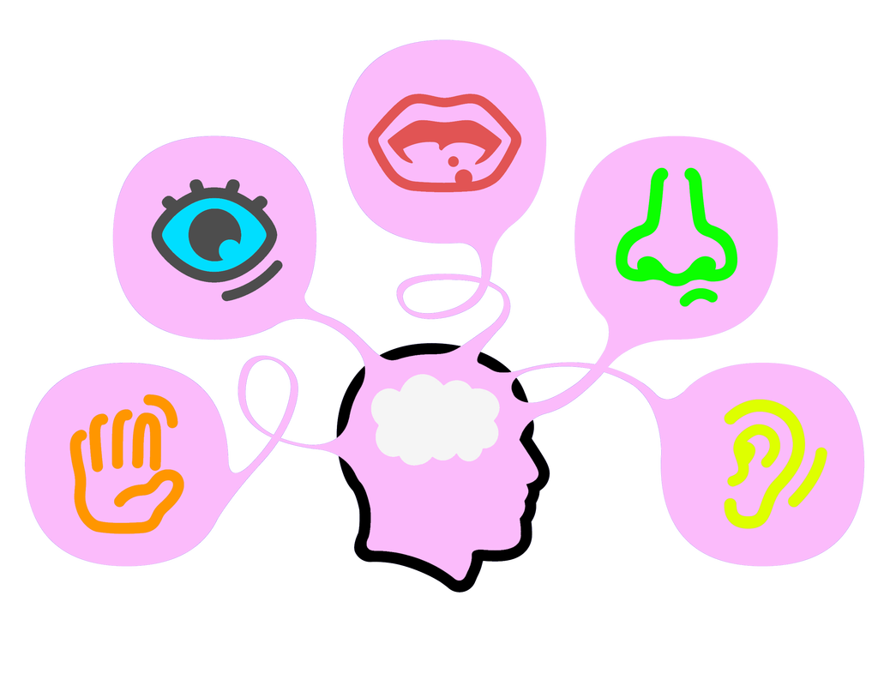
5, 4, 3, 2, 1
Good for breaking a thought that won’t go away
Works by taking your focus away from the thought and onto something else
Name out loud:
5 things you can see.
4 things you can touch.
3 things you can hear.
2 things you can smell.
1 thing you can taste.
Notes:
54321 is a great way of distracting yourself, especially when you have a thought that won’t go away and it’s causing you feel stressed, or down or angry or even a bit panicky.
Let’s try this one. I’m not going to ask you to think about something that stresses you out. So we’ll use something neutral to practise with.
First of all, picture something in your head that you can see very clearly – your pet, your favourite actor, a song that gets stuck in your head….
Now, look around you. Name 5 things you can see – say it out loud.
Next, touch 4 things that are near you – say the names out loud
Next, listen carefully and name out loud three things you can hear
Next, what can you smell? Name two things out loud.
Finally, what can you taste? What is the taste in your mouth right now – name it out loud.
Are you still thinking about the thing you were before you started? I hope not! If you give the 54321 process your full attention it breaks your train of thought and lets you start thinking about something else.
Image Source: https://www.bing.com/images/search?view=detailV2&ccid=6IB%2fyhla&id=CA4C19929F4F7CC4DA55668D2F9108FA497B9DA9&thid=OIP.6IB_yhlaTqIN5m1YfPwzgQHaFt&mediaurl=https%3a%2f%2fwebstockreview.net%2fimages%2f5-senses-clipart-transparent-4.png&exph=800&expw=1038&q=senses+transparent&simid=608039327884577549&ck=C2086FC14CAFDD92EF52E21B3FBB82B5&selectedIndex=2&FORM=IRPRST&ajaxhist=0

Slide 11
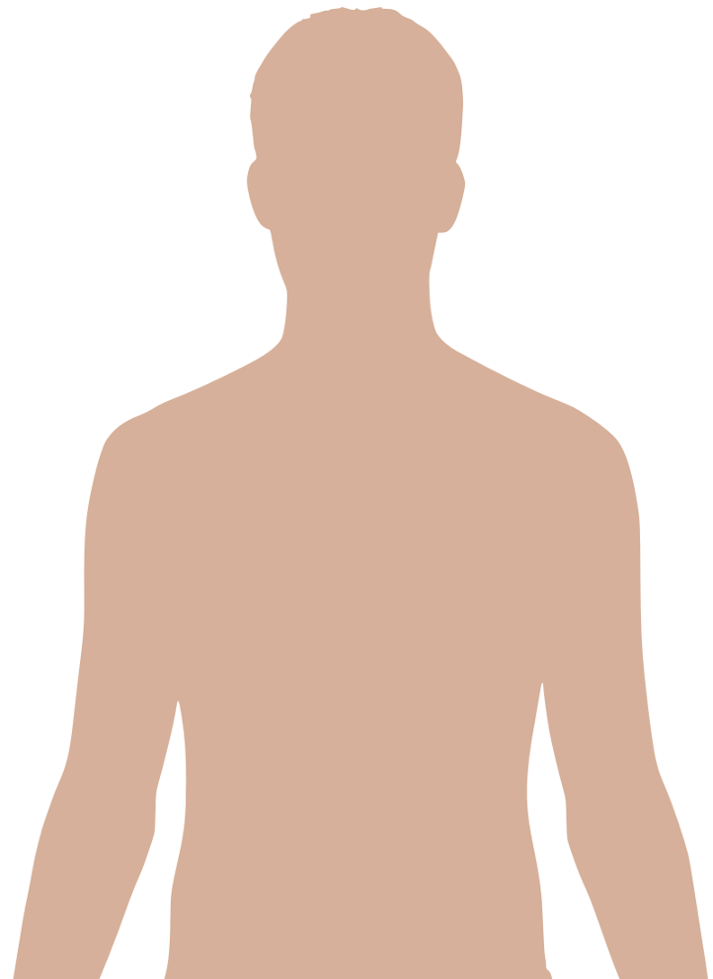
Drop 3
Good for relaxing when you need a quick and not very obvious technique
Works by helping your brain to relax muscles by giving it a few cues to get started
Drop your jaw, let your tongue fall to the bottom of your mouth.
Drop your shoulders.
Drop your stomach.
Notes:
This is a one you can do anywhere and if you don’t want anyone to know, you can do it in a not very obvious way. This is a great, quick relaxation technique that just takes a few seconds to do but helps you feel relaxed quickly.
Drop your jaw. Make sure your tongue falls to the bottom of your mouth. If your mouth is open a little, you’re doing it right.
Drop your shoulders. Let them loosen and fall
Drop your stomach. Don’t hold it in tight; just let it go. Now notice how you feel. Has anything changed?
Image Source: https://upload.wikimedia.org/wikipedia/commons/9/92/Man_shadow_-_upper.png

Slide 12
Don’t forget to complete our survey!
Help us to help you!
Click Here for Survey
aspire-higher.co.uk/
@AspireHigherNet
Notes:
Help us to help you.
Please complete the survey.
Photo source https://www.eurodrying2019.com/uk/page.asp?PID=97
Company logo: Twitter

Slide 13
Success with Stress: Distraction and Relaxation

