Slide 1
Success with Stress: What are Stress and Resilience?
Notes:
Welcome.
Introduce yourself – Smile!
Explain Aspire higher are University of Northampton, University of Bedford and University of Hertfordshire working together to increase participation in higher education.

Slide 2
Want this resource in another format?
If you require this presentation with an audio voiceover and subtitles, click the link below.
Click Here for What are Stress and Resilience with Audio and Subtitles
Help us to help you
Use the button to adjust subtitle options

Slide 3
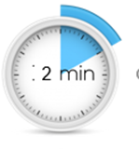
Help us to help you!
Please complete the survey – it takes just 2 minutes!
It will help us support you more in the future!
Help us to help you
Click here for survey
Notes:
Help us to help you.
Please complete the survey – it takes just 2 minutes
It will help us support you more in the future
Picture source https://www.freepngimg.com/internet/feedback

Slide 4
What are stress and resilience?
Stress [strɛs]
NOUN
a state of mental or emotional strain or tension resulting from adverse or demanding circumstances.
Resilience [rɪˈzɪlɪəns]
NOUN
the capacity to recover quickly from difficulties; toughness.
Notes:
This video is going to revisit the first section of the workshop which looks at what stress and resilience are, how they connect and how feeling and stress connect.

Slide 5
What is Stress?
Stress is a normal response from your body when it feels threatened.
Fight or flight response
Feelings of fear, anxiety, anger
Notes:
Stress is a normal response we feel when we feel threatened by something. It triggers our fight or flight response. Basically, its evolved with humans to help us stay alive by running away from that dangerous animal or by fighting our way out when we’re cornered by warriors from the next tribe over. Its still useful now too – in small doses. All the healthy living tips you’ve been hearing throughout the Coronavirus Pandemic are part of dealing with the stressful situation and so is our resilience.
Another example is when you go into the exam room, take your driving test or be faced with a new situation, you might feel nervous. Again, that’s totally normal – your body has recognised a potentially stressful situation and flooded your body with a hormone called adrenalin as that’s the automatic reaction. You can’t stop it happening, but you can take steps to bring down your stress levels and feel less nervous or anxious. That’s where resilience comes in.
Image Source: https://static.thenounproject.com/png/1760-200.png

Slide 6
What is Resilience?
Resilience is the mental processes we all have to deal with challenging and difficult situations.
You have it and you can work on it so you have more
Notes:
We all have resilience – it the mental processes that helps us cope when things are a bit challenging and bounce back after we have gone through something difficult. It’s something we can develop so we have a bigger reserve of mental energy to help us feel better when we feel stressed or are having a hard time. So the aim of this video series is introduce you to some ideas that you can use to try and help you manage your feelings in stressful situations and build your resilience up even more.
There are a few things that really help with our resilience–
being positive. Using positive language really does make a difference to how you think and feel if you keep doing it.
Being able to regulate our emotions. Recognising what we’re feeling and why and recognising that feelings aren’t permanent and they pass is important to helping us cope with negative feelings.
Being able to learn when we don’t get things right. Being able to learn from getting things wrong is an important form of feedback and being able to use it really helps us see things in a different way.
Resilience is something we can develop so we have a bigger reserve of mental energy to help us feel better when we feel stressed or are having a hard time. So what I want do here is introduce you to some ideas that you can use to try and help you manage day-to-day stress and build your resilience up even more.
The techniques you’ll learn in this series of videos will, with a bit of practise, become part of your resilience toolkit and you can use them to help you to reclaim a calm and focussed state of mind so you can do your best to cope with what ever stressful situation you come up against. They are good for helping you now, during lockdown and the gradual return to life outside the home coming up over the rest of this year but they’re also useful for any stressful situation you find yourself needing a bit of calm in – exams, driving tests, job interviews, meeting your partner’s parents…..
Image Source: https://d30y9cdsu7xlg0.cloudfront.net/png/147367-200.png

Slide 7
How does this connect to resilience?
Stressful situations need resilience to deal with them
Finding ways to deal with negative emotions is building your resilience
These techniques are extra tools in your Resilience Toolkit
Notes:
As we’ve said, resilience is your ability to deal with and bounce back from challenging situations. Any situation that makes you feel stress, like staying home during lockdown or having to deal with your family all day or doing exams can be very challenging so developing skills that you can use in the moment is as important to resilience as being able to deal with challenges or difficult situations that might be lower stress but last longer. So the more tools that work for you that you have at your fingertips, and the more practised you are in using them, the better the result is for your mental wellbeing. Have a look at our Looking After Yourself in Tough Times presentation too for some tips on longer term strategies you can use to help you on a day-to-day basis.
Image Source: https://angelairvin.files.wordpress.com/2014/12/black-icon-transparent-background.png?w=1387&h=1519
.

Slide 8
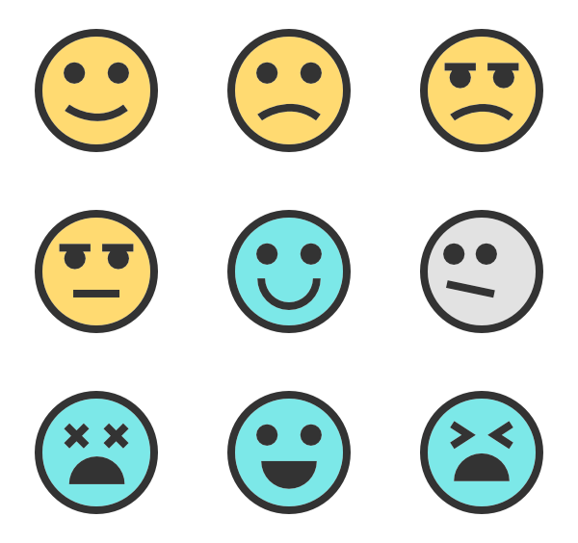
I’m practising but I’m still feeling feelings
That’s OK
That’s normal
Feelings pass
You’re OK
Notes:
Yes, you will. This isn’t about stopping feelings – they are important and you’re feeling them for a reason. This is about helping you recognise when you feel them and what you can do to help yourself stop feeling worse and feel more in control. The techniques I’m going to show you aren’t about stopping feelings, but giving yourself some help to manage them.
It is important that if you are having negative emotions for too long, you tell someone, it could be that just talking to someone you trust about it could make you feel better – don’t bottle it up. If that doesn’t help, then tell your parents/carers and/or GP who can find you the right help and support.
Image Source: https://www.bing.com/images/search?view=detailV2&ccid=W%2b1tZBJD&id=C25C5AD859E4C3F34CE962DF2E98764F39568FD8&thid=OIP.W-1tZBJDS5W0kscGGgYLiAHaG9&mediaurl=http%3a%2f%2fpluspng.com%2fimg-png%2fpng-emotions-faces-faces-and-emotions-600.png&exph=564&expw=600&q=feelings++transparent&simid=608031240369209748&ck=1493AE7994FD0BA012AAE4F9B30BEC3B&selectedIndex=4&FORM=IRPRST&ajaxhist=0

Slide 9
What do I do now?
Keep practising a bit every day
You’re learning new skills and they need you to practise to get good at them
Try the things we’ve looked at – what works best for you?
Notes:
The more you practise, the easier doing these things will be and when you need them, they’ll work for you. Like any other skills, you need to put a bit of effort in now for a good outcome later.
So, its over to you now. Try out the different techniques and see what works best for you then keep them in your resilience toolbox. Take them out now and again and practise the ones that work best for you, so you have them handy when you need them. Use them when you need them so they help you get control of your calm.

Slide 10
Don’t forget to complete our survey!
Help us to help you!
Click Here for Survey
aspire-higher.co.uk/
@AspireHigherNet
Notes:
Help us to help you.
Please complete the survey.
Photo source https://www.eurodrying2019.com/uk/page.asp?PID=97
Company logo: Twitter

Slide 11
Success with Stress: What are Stress and Resilience?
Notes:
Welcome.
Introduce yourself – Smile!
Explain Aspire higher are University of Northampton, University of Bedford and University of Hertfordshire working together to increase participation in higher education.

