Slide 1
Developing Transferable Skills: Teamwork

Slide 2
Help us to help you!
Please complete the survey – it takes just 2 minutes!
It will help us support you more in the future!
Help us to help you
Click here for survey
Notes:
Help us to help you.
Please complete the survey – it takes just 2 minutes
It will help us support you more in the future
Picture source https://www.freepngimg.com/internet/feedback

Slide 3
Content of the session
What are transferable skills and why are they important?
What is teamwork?
Teamwork task
Notes:
This resource is going to cover 3 sections, What are transferable skills and why are they important, what is teamwork and a teamwork task.

Slide 4
What are transferable skills and why are they important?
It’s all about complementing your education!
Notes:
What are transferable skills and why are they important?
Its all about complementing your education.

Slide 5
What are transferable skills?
There are many transferable skills.
In this session we will be focusing on Teamwork.
Adaptability
Creativity
Proactivity
Communication
Resilience
Leadership
Teamwork
Problem Solving
Notes:
What are transferable skills? There are many transferable skills
Problem solving skills are about the ability to find a solution to a complex situation or challenge
Creativity is the use of imagination and the generation of new ideas
Listening and presenting (communication) is the receiving, retaining and processing of information or ideas as well as the oral transmission
Leadership is about supporting, encouraging and motivating others to achieve a shared goal
Proactive, is the ability to set clear, tangible goals and devise a robust route to achieving them as well as taking the initiative and making things happen, instead of always reacting to what happens around you
Staying positive or Resilience is about the ability to use tactics and strategies to overcome setbacks and achieve goals
Adaptability is the ability to cope and thrive in changing conditions
This resource is focusing on Teamwork.

Slide 6
Why are transferable skills important?
They are skills developed from your previous professional experience, education or even extra curricular activities and hobbies.
These skills can be applied to a range scenarios where you thought you didn’t have any relevant experience.
Notes:
Why are transferable skills important?
They are skills developed from your previous professional experience, education or even extra curricular activities and hobbies.
These skills can be applied to a range scenarios where you thought you didn’t have any relevant experience.
Image source: https://piaastaticwebsitedemo.wordpress.com/cloudticity/

Slide 7
What is teamwork?
We are all working together.
Notes:
What is team work?
We are all working together.

Slide 8
Teamwork
Teamwork means you have the ability to work with others towards achieving a common goal.
Effective teamwork requires several other qualities such as empathy, active listening and strong communication.
Have teamwork examples for interviews – employers will like this!
Notes:
Teamwork means you have the ability to work with others towards achieving a common goal.
Effective teamwork requires several other qualities such as empathy, active listening and strong communication. Have examples of how you have worked in a team at any interview.
Image source: https://www.fycargo.com/

Slide 9
Teamwork task
How can I evidence teamwork effectively?
Notes:
Teamwork task.
How can I evidence teamwork effectively?

Slide 10
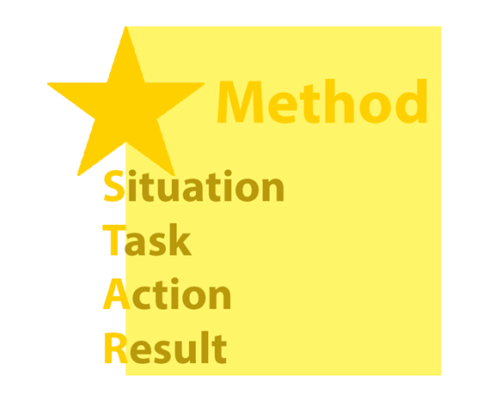
Activity
Think of a time when you have worked well as part of a team.
Use the STAR method below to demonstrate this skill.
Describe the Situation
What Action did you take?
Explain the Task
What was the Result?
The STAR response method can help structure answers.
Let’s try this thinking about teamwork.
Notes:
Task
Think of a time when yu have worked well as part of a team,
The STAR response method can help structure answers.
S - Describe the situation
T – Explain the task
A – What Action did you take
R – What was the result
Let’s try this thinking about teamwork.
Use the STAR method to demonstrate your skill.
Image source: https://blog.jobtestprep.co.uk/star-method-interview-example-1

Slide 11
Example
In Year 12, I played Centre Forward in the school Football Team. This year we made it into the School Cup Final, the first time in 10 years. I was made captain and I spoke to the team before the game about our game plan - working together as a team would give us the best chance of winning the cup. We were playing well, the score was 2-1, and at that point, I hadn’t scored, but I had set up 4 chances for my team (we scored 2 of them)! I remember I got a chance to shoot, and was really desperate to score, but I could see my team mates were in a better position to do so, so I passed. Then 20 minutes before the end of the game, our goalie fell and injured their leg which was devastating to the team as nobody else had the confidence to play in goal. So, as captain, I decided to put the needs of the team before mine and put on the gloves for the rest of the match. We kept the score at 2-1 and won the cup! We worked as a team and put the teams needs before any individuals and celebrated of winning the competition.
Situation
Task
Action
Result
Task
Can you think of your own responses for a times you have shown excellent teamwork skills?
Notes:
Example given:
In Year 12, I played Centre Forward in the school Football Team. This year we made it into the School Cup Final, the first time in 10 years. I was made captain and I spoke to the team before the game about our game plan - working together as a team would give us the best chance of winning the cup. We were playing well, the score was 2-1, and at that point, I hadn’t scored, but I had set up 4 chances for my team (we scored 2 of them)! I remember I got a chance to shoot, and was really desperate to score, but I could see my team mates were in a better position to do so, so I passed. Then 20 minutes before the end of the game, our goalie fell and injured their leg which was devastating to the team as nobody else had the confidence to play in goal. So, as captain, I decided to put the needs of the team before mine and put on the gloves for the rest of the match. We kept the score at 2-1 and won the cup! We worked as a team and put the teams needs before any individuals and celebrated of winning the competition.

Slide 12
Don’t forget to complete our survey!
Help us to help you!
Click here for survey
aspire-higher.co.uk/
@AspireHigherNet
Notes:
Help us to help you.
Please complete the survey.
Photo source https://www.eurodrying2019.com/uk/page.asp?PID=97
Company logo: Twitter

Slide 13
Developing Transferable Skills: Teamwork

