Slide 1
Developing Transferable Skills: Resilience

Slide 2
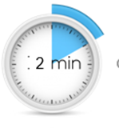
Help us to help you!
Please complete the survey – it takes just 2 minutes!
It will help us support you more in the future!
Help us to help you
Click here for survey
Notes:
Help us to help you.
Please complete the survey – it takes just 2 minutes
It will help us support you more in the future
Picture source https://www.freepngimg.com/internet/feedback

Slide 3
Content of the session
What are transferable skills and why are they important?
What is resilience?
Resilience task
Notes:
This resource will cover what are transferable skills and why are they important , what is resilience and a reliance task.

Slide 4
What are transferable skills and why are they important?
It’s all about complementing your education!
Notes:
What are transferable skills and why are they important?
Its all about complementing your education.

Slide 5
What are transferable skills?
There are many transferable skills.
In this session we will be focusing on Resilience.
Adaptability
Creativity
Proactivity
Communication
Resilience
Leadership
Teamwork
Problem Solving
Notes:
What are transferable skills? There are many transferable skills
Problem solving skills are about the ability to find a solution to a complex situation or challenge
Creativity is the use of imagination and the generation of new ideas
Listening and presenting (communication) is the receiving, retaining and processing of information or ideas as well as the oral transmission
Leadership is about supporting, encouraging and motivating others to achieve a shared goal
Proactive, is the ability to set clear, tangible goals and devise a robust route to achieving them as well as taking the initiative and making things happen, instead of always reacting to what happens around you
Staying positive or Resilience is about the ability to use tactics and strategies to overcome setbacks and achieve goals
Adaptability is the ability to cope and thrive in changing conditions
This resource is focusing on Resilience

Slide 6
Why are transferable skills important?
They are skills developed from your previous professional experience, education or even extra curricular activities and hobbies.
These skills can be applied to a range scenarios where you thought you didn’t have any relevant experience.
Notes:
Why are transferable skills important?
They are skills developed from your previous professional experience, education or even extra curricular activities and hobbies.
These skills can be applied to a range scenarios where you thought you didn’t have any relevant experience.
Image source: https://piaastaticwebsitedemo.wordpress.com/cloudticity/

Slide 7
What is resilience?
So what is the best route to resilience?
Notes:
What is resilience?
So what is the best route to resilience?

Slide 8
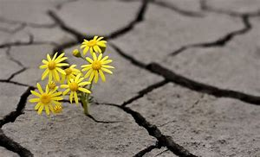
Resilience
Resilience refers to your ability to deal with setbacks. How well do you cope with stressful situations or when something goes wrong?
How do you react to unexpected changes or problems that occur during a project?
You aren't expected to be unaffected by these events, but you need to be able to show that you react to them positively and can develop strategies to deal with them.
Notes:
You aren't expected to be unaffected by these events, but you need to be able to show that you react to them positively and can develop strategies to deal with them.
Resilience refers to your ability to deal with setbacks. How well do you cope with stressful situations or when something goes wrong?
How do you react to unexpected changes or problems that occur during a project?
Image source: http://www.montanamedicalresearch.com/current-studies/

Slide 9
Developing your resilience
You aren’t expected to be a super human - know when to ask for help
Try new experiences and fail in a safe environment
Have a positive ‘can do’ attitude
Be focused and proactive in what you do
Be organised yet flexible in your approach
Attend stress management or resilience workshops
Notes:
Developing your resilience.
You aren’t expected to be a super human - know when to ask for help
Have a positive ‘can do’ attitude
Be organised yet flexible in your approach
Try new experiences and fail in a safe environment
Be focused and proactive in what you do
Attend stress management or resilience workshops
.Image source: https://www.indiamart.com/proddetail/cast-iron-compression-spring-19473463548.html

Slide 10
Resilience task
Let’s help you with building this up….
Notes:
Resilience task
Let’s help you with building this up

Slide 11
Activity
Self care and keeping your body and mind primed is important when you are working on your resilience.
Try some of the activities to build your resilience.
Give yourself a break from media. Set a time in your day with no social media, news or radio.
Practice relaxation methods such as deep breathing, meditation, mindfulness or yoga.
Notes:
Task
Self care and keeping your body and mind primed is important when you are working on your resilience.
Try some of the activities to build your resilience.
Give yourself a break from media. Set a time in your day with no social media, news or radio
Practice relaxation methods such as deep breathing, meditation, mindfulness or yoga
Image 1 source: https://pwestpathfinder.com/2019/11/05/no-social-media-students-share-their-stories/
Image 2 source: https://www.theodysseyonline.com/7-websites-for-when-things-get-bad
Image 3 source: https://www.kissclipart.com/free/yoga,22.html

Slide 12
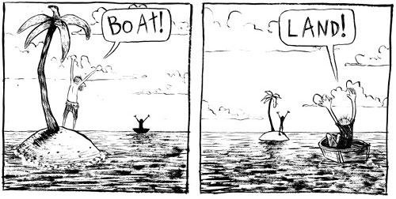
Activity
Pay attention to your general well-being:
Diet, sleep and exercise.
Keep life simple. Enjoy simple pleasures such as watching the sun set.
Reframe a difficult experience. Try and see it from a different view point.
Notes:
Pay attention to your general well-being: Diet, sleep and exercise
Keep life simple. Enjoy simple pleasures such as watching the sun set.
Reframe a difficult experience. Try and see it from a different view point.
Image source 1: https://digitalobby.spu.edu/wellness/2019/05/15/sleep-exercise-and-nutrition/
Image source 2: http://marionbevington.com/whats-your-opinion-of-your-perspective/
Image source 3: https://webstockreview.net/pict/getfirst

Slide 13
Don’t forget to complete our survey!
Help us to help you!
Click here for survey
aspire-higher.co.uk/
@AspireHigherNet
Notes:
Help us to help you.
Please complete the survey.
Photo source https://www.eurodrying2019.com/uk/page.asp?PID=97
Company logo: Twitter

Slide 14
Developing Transferable Skills: Resilience

