Slide 1
Developing Transferable Skills: Proactivity

Slide 2
Help us to help you!
Please complete the survey – it takes just 2 minutes!
It will help us support you more in the future!
Help us to help you
Click here for survey
Notes:
Help us to help you.
Please complete the survey – it takes just 2 minutes
It will help us support you more in the future
Picture source https://www.freepngimg.com/internet/feedback

Slide 3
Content of the session
What are transferable skills and why are they important?
What is proactivity ?
Proactivity Task
Notes:
In this resources it will cover transferable skills and why are they important, what is proactivity and a proactivity task.

Slide 4
What are transferable skills and why are they important?
It’s all about complimenting your education!
Notes:
What are transferable skills and why are they important?
Its all about complimenting your education

Slide 5
What are transferable skills?
There are many transferable skills.
In this session we will be focusing on Proactivity.
Adaptability
Creativity
Proactivity
Communication
Resilience
Leadership
Teamwork
Problem Solving
Notes:
What are transferable skills and why are they important?
Problem solving skills are about the ability to find a solution to a complex situation or challenge
Creativity is the use of imagination and the generation of new ideas
Listening and presenting (communication) is the receiving, retaining and processing of information or ideas as well as the oral transmission
Leadership is about supporting, encouraging and motivating others to achieve a shared goal
Proactive, is the ability to set clear, tangible goals and devise a robust route to achieving them as well as taking the initiative and making things happen, instead of always reacting to what happens around you
Staying positive or Resilience is about the ability to use tactics and strategies to overcome setbacks and achieve goals
Adaptability is the ability to cope and thrive in changing conditions
This resource is focusing on proactivity

Slide 6
Why are transferable skills important?
They are skills developed from your previous professional experience, education or even extra curricular activities and hobbies.
These skills can be applied to a range scenarios where you thought you didn’t have any relevant experience.
Notes:
Why are transferable skills important?
They are skills developed from your previous professional experience, education or even extra curricular activities and hobbies.
These skills can be applied to a range scenarios where you thought you didn’t have any relevant experience.
Image source: https://piaastaticwebsitedemo.wordpress.com/cloudticity/

Slide 7
What is proactivity?
Let’s not just react all the time?
Notes:
What is proactivity
Let’s not just react all the time?

Slide 8
Proactivity
Being proactive means seeing potential problems before they arise and taking care of them - employers appreciate this skill!
Proactive behaviour involves acting in advance of a future situation, rather than just reacting.
Notes:
Proactivity
Being proactive means seeing potential problems before they arise and taking care of them - employers appreciate this skill!
Proactive behaviour involves acting in advance of a future situation, rather than just reacting
Image source: https://www.facebook.com/ProactiveMind8712

Slide 9
Proactivity
What are the characteristics of being proactive and not reactive?
Plan for the future and think long term
What are the alternatives?
Accept constructive criticism
Aware of strengths and areas of development
Use positive language
Prevents things through problem solving
Being a doer and having perseverance
Notes:
The characteristics of proactivity rather than reactive:
Plan for the future and think long term
Aware of strengths and areas of development
Prevents things through problem solving
What are the alternatives?
Accept constructive criticism
Use positive language
Image source: http://www.cencaltek.com/blog/

Slide 10
Proactivity task
How can I evidence this transferable skill?
We can all be SMART!
Notes:
Proactivity task.
How can I evidence this transferable skill? We can all be SMART

Slide 11
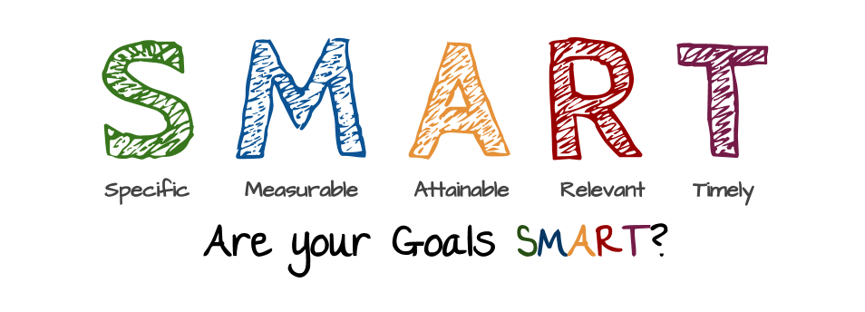
Activity
What is a SMART goal?
A SMART Goal helps you clarify exactly what you want to achieve and focus your efforts, ultimately making you more likely to succeed.
See the next slide for your task…
Notes:
Task
What is a SMART goal?
A SMART Goal helps you clarify exactly what you want to achieve and focus your efforts, ultimately making you more likely to succeed.
Image source: https://www.project-management.pm/setting-goals/

Slide 12
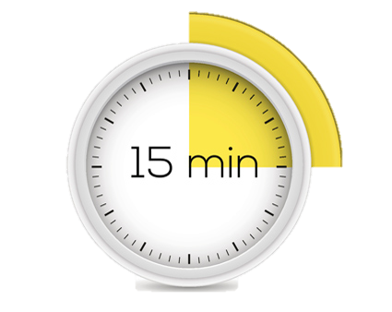
Activity
SMART Goal example:
‘I will obtain a job as a school maths teacher within three months after graduating with my Bachelor of Science in Education.’
Specific
Becoming a school maths teacher
Measurable
Number of applicants, interviews and job offers
Achievable
Having the appropriate degree for the job
Relevant
The degree is suitable for the education sector
Timely
Within 3 months of graduation
Activity – Now think of a goal and use SMART to help you achieve it.
Notes:
Task
Now think of a goal and use SMART to help you achieve it.
SMART stands for
Specific
Measurable
Achievable
Relevant
Time based

Slide 13
Don’t forget to complete our survey!
Help us to help you!
Click here for survey
aspire-higher.co.uk/
@AspireHigherNet
Notes:
Help us to help you.
Please complete the survey.
Photo source https://www.eurodrying2019.com/uk/page.asp?PID=97
Company logo: Twitter

Slide 14
Developing Transferable Skills: Proactivity

