Slide 1
Developing Transferable Skills- Communication

Slide 2
Content of the session
What are transferable skills and why are they important?
What do we mean by communication?
Communication task

Slide 3
What are transferable skills and why are they important?
It’s all about complimenting your education!

Slide 4
What are transferable skills?
There are many transferable skills.
In this session we will be focusing on Communication.
Adaptability
Creativity
Proactivity
Communication
Resilience
Leadership
Teamwork
Problem Solving
Notes:
Problem solving skills are about the ability to find a solution to a complex situation or challenge
Creativity is the use of imagination and the generation of new ideas
Listening and presenting (communication) is the receiving, retaining and processing of information or ideas as well as the oral transmission
Leadership is about supporting, encouraging and motivating others to achieve a shared goal
Proactive, is the ability to set clear, tangible goals and devise a robust route to achieving them as well as taking the initiative and making things happen, instead of always reacting to what happens around you
Staying positive or Resilience is about the ability to use tactics and strategies to overcome setbacks and achieve goals
Adaptability is the ability to cope and thrive in changing conditions

Slide 5
Why are transferable skills important?
They are skills developed from your previous professional experience, education or even extra curricular activities and hobbies.
These skills can be applied to a range scenarios where you thought you didn’t have any relevant experience.

Slide 6
Communication
We all talk but is that all that’s involved?

Slide 7
Communication skills
Strong communication is the ability to give information to others by speaking, writing or many other mediums.
Read body language
Know how to ask questions
In the workplace, employers value strong communicators for their ability to work with others and move projects forward.
Talk in different contexts

Slide 8
Developing Communication skills
Good communication allows others to receive, retain and process the information you are giving.
Verbal
communication using spoken words
Non Verbal communication through body language
Written communication using emails, messages, reports etc...

Slide 9
Communication task
Putting it into practice, let’s watch and listen.

Slide 10
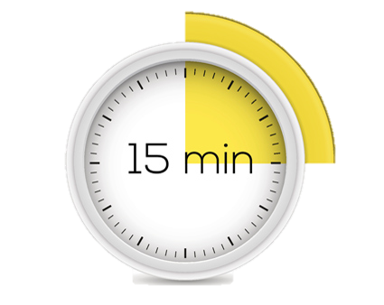
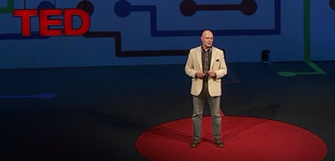
Task
Watch this TED talk about effective communication.
Make notes about the key ideas listed below.
Click here for the TED talk
(10 mins)
The 7 Deadly Sins of Talking
The HAIL Approach
Top Tips for Communication

Slide 11
Thank you for listening
Tell us what you think
www.aspire-higher.co.uk
Notes:
I hope that dispenses some myths around apprenticeships and gives you the ability into making an informed choice.
Thank you for listening. Any questions?
Answer any questions.
I will be here for a few minutes if any of you would like to ask questions on the way out otherwise you can tweet aspirehigher,net.

Slide 12
Developing Transferable Skills- Communication

