Slide 1
Social Media:
Social Media and Me
Notes:
Welcome.
Introduce yourself and remember to smile.
Aspire higher are University of Northampton, University of Bedford and University of Hertfordshire working together to increase students participation into Higher Education. When we say Higher Education that could be a HNC, HND, Degree, apprenticeship, any level 4 qualification.
Today we will be learning about social media

Slide 2


Want this resource in another format?
If you require this presentation with an audio voiceover and subtitles, click the link below.
Click Here for Social Media and Me Presentation with Audio and Subtitles - No Activities
Help us to help you
Use the button to adjust subtitle options

Slide 3


Help us to help you!
Please complete the survey – it takes just 2 minutes!
It will help us support you more in the future!
Help us to help you
Click here for survey
Notes:
Help us to help you.
Please complete the survey – it takes just 2 minutes
It will help us support you more in the future
Picture source https://www.freepngimg.com/internet/feedback

Slide 4
Content of the session
What is social media?
The power of your digital footprint
Social media and digital footprints: our responsibilities.
Notes:
It today's session we will be covering 3 sections, what is social media, the power of your digital footprint and social media and our responsibilities.

Slide 5
What is Social Media?
It’s just a fun way of keeping in touch with my friends?
Notes:
What is social media?
I’m guessing you see it a a fun way of keeping in touch with my friends?

Slide 6









Types of Social Media
Keeping in touch
Buisness
Sharing Experiences
Networking
Notes:
Social media is the collective of online communications channels dedicated to community-based input, interaction, content-sharing and collaboration. Websites and applications dedicated to forums, microblogging, social networking, social bookmarking, social curation, and wikis are among the different types of social media
People use social media for different reasons. These could be sharing experiences with people, marketing your business, networking or just keeping in touch.
Picture source company logos:
Skype
Instagram
Facebook
YouTube
LinkIn
Snap Chat
Whatsapp
Tik Tok
Twitter

Slide 7
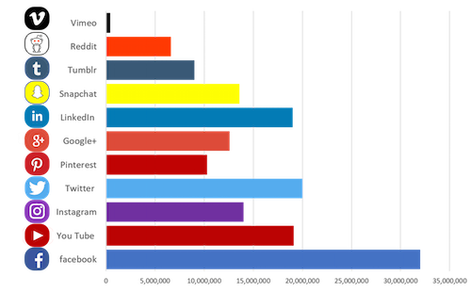
Use of Social Media
Usage facts
45 million active users of social media in the UK
(January 2020)
66% of the UK are active
social media users
(January 2020)
On average, active users spend 2 hours 23 minutes daily using social media
Notes:
All social media is usage is a variety of amounts with Facebook still being the most popular platform in the UK.
The amount we use social media can vary but its worth remembering that 66% of the UK population are on social media. That means potentially anything you post could be visible to 2/3 of the population.
In January 2020 there were 45 million active users of social media in the UK, that could of risen due to lockdown? On average users spend 2 hours and 23 minutes on social media, again this is more than lightly risen in the past few months.
Image source: http://www.socialmediafirst.info/blog/2018/07/most-powerful-social-media-platforms-uk-2018/

Slide 8

Activity
Social Media Platforms
Name as many social media platforms that you can.
Name as many social media platforms as you can
Would it be appropriate to use for education or business?
Now decide the purpose of each platform.
Would it be appropriate to use for education or business?
Notes:
Discussion:
How many do you use/have used?
What is each platform used for?
Discuss which platforms are acceptable or not acceptable to use within the work place.
Why is it acceptable or why is it not?

Slide 9
The power of your digital footprint
What can it actually do?
Notes:
The power of your digital footprint.. What can it actually do?

Slide 10

What is a ‘digital footprint?’
A digital footprint is all the information online about a person posted either intentionally or unintentionally.
.
Remember:
Your digital footprint is permanent and can be searched, shared, copied and broadcast by others
Notes:
Firstly what is your Digital footprint ? Its all the information online about a person posted either by that person or by others, intentionally or unintentionally
Every time you go online it leaves a footprint, this can be searched, copied shared and broadcasted.
Anyone who can see information about you or posted by you online, whether you intended them to or not. Its an invisible audience,
You need to remember this is Permanent anything that goes online is virtually impossible to remove.
Image source: https://www.techwyse.com/blog/2012/04/

Slide 11

Achieving a good digital footprint
So what can you do?
Be kind
Use privacy settings
Read the T&Cs
Keep a list of accounts
Google
yourself
Publishing is forever
Notes:
You are young enough to start out on the right foot ensuring the digital footprint that you leave is a good one.
A good place to start is to be kind, making sure that the footprints you leave are positive ones that you would be pleased for someone else to find.
Always use privacy settings to limit your audience. No matter how high you set your privacy settings things can always be found and shared. What is stopping anyone from taking a screen shot of your post and distributing it? Do you know how much of your content that companies own? No? Read the T&Cs you may be surprised the power you are giving them over your content. Its always worth keeping a list of account your own and delete ones you are not using.
Google yourself, it’s the easiest way to see what anyone in the WORLD can see about you. Remember when you send anything or post anything think of it as publishing it forever.
Picture source: https://defradigital.blog.gov.uk/2020/01/10/new-year-new-start-the-changes-that-im-pledging-to-my-digital-footprint/

Slide 12
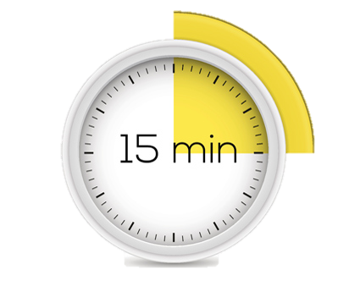
Activity
Your digital footprint
Watch the video below and think about these questions:
Think what was the last thing you shared?
How is this representing you?
What are you posting now?
What image is that creating of you in 10 years time?
https://www.youtube.com/watch?v=RVX8ZSAR4OY
Notes:
15 minute activity
Watch the video
https://www.youtube.com/watch?v=RVX8ZSAR4OY
Think what was the last thing you shared?
How is this representing you?
What are you posting now?
What image is that creating of you in 10 years time?

Slide 13
Social media and digital footprints: our responsibilities
Whose responsibility is it?
Notes:
Social media and digital footprints our responsibilities.
Whose responsibility is it?

Slide 14
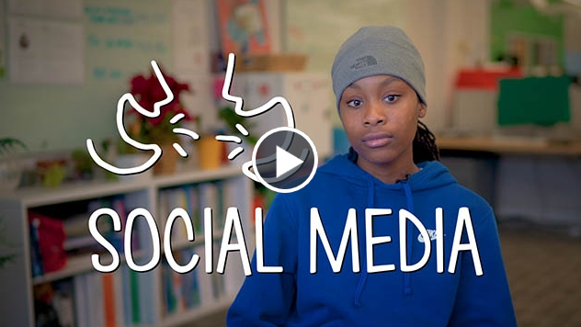
Oversharing your digital footprint
Let’s watch this video
What does your digital footprint say about you?
Social Media Video Link
Notes:
Lets watch this short video, students are talking about their digital footprints. Think what your digital footprints say about you?

Slide 15
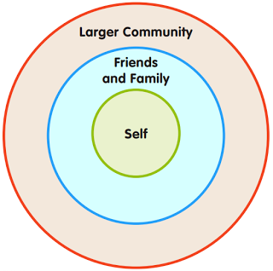
Rings of Responsibility
What image are you giving?
What image are you giving?
How does your digital footprint show you?
How does your digital footprint effect family and friends?
Notes:
These are the Rings of Responsibility, which we use to think about the different people we have responsibilities to.
Having "responsibilities to" someone means that you think about how your actions will affect them. How many times have we tagged or shared something without thinking how it might effect this person?
By posting on social media your actions could effect them and their digital footprint. Equal what are people posting and sharing that could affect your footprint?
Picture source: http://www.crazy4computers.net/rings-of-responsibility.html

Slide 16
Impact: how can this effect you?
What do the employers say?
Posting inappropriate photos of comments
(11%)
Negative comments about employers
(11%)
Showing poor communication skills
(11%)
Discriminatory comments
(10%)
Posting about taking drugs
(10%)
Posting about drinking
(9%)
  69% of employers say they have rejected candidates
  based on their social media activity
.
Notes:
The next time you post anything on social media, just think if this is what you would like a future teacher, tutor, employer to think about you in 5, 10 or 15 years time?
If you are including other people in your posts, how is this going to effect them? We could all name someone in the public eye who has posted, tweeted, re tweeted or even just like a post that has come back to haunt them. This could easily happen to you. Once it’s posted the content is there.
Remember 69% of employers say they have rejected candidates
based on their social media activity

Slide 17
Activity – Google Yourself
What do you see when you Google yourself?
What information do you find? Are there any images?
What have you been tagged into?
Is there any other interesting information you can find from your Google search?
Notes:
Activity :
Start from today. Be more aware of what you post online.
Google yourself:
See what surprises you, how many photos did you find, any embarrassing ones?
How easy was it to find something, how much information did you need to enter any additional information to narrow down the search?
Go and check your privacy settings on all you social media. If you are no longer using that platform, delete your profile.

Slide 18



Don’t forget to complete our survey!
Help us to help you!
Click here for survey
aspire-higher.co.uk/
@AspireHigherNet
Notes:
Help us to help you.
Please complete the survey.
Photo source https://www.eurodrying2019.com/uk/page.asp?PID=97
Company logo: Twitter

Slide 19
Social Media: Social Media and Me

