Slide 1
Social Media
Learning about LinkedIn
Notes:
Welcome.
Introduce yourself and remember to smile.
Aspire higher are University of Northampton, University of Bedfordshire and University of Hertfordshire working together to increase students participation into Higher Education. When we say Higher Education that could be a HNC, HND, Degree, apprenticeship, any level 4 qualification.
Today we are talking about Social Media and learning about Linked in.

Slide 2


Want this resource in another format?
If you require this presentation with an audio voiceover and subtitles, click the link below.
Click Here for Learning about Linkedin Presentation with Audio and Subtitles - No Activites
Help us to help you
Use the button to adjust subtitle options

Slide 3
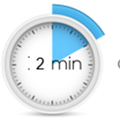

Help us to help you!
Please complete the survey – it takes just 2 minutes!
It will help us support you more in the future!
Help us to help you
Click here for survey
Notes:
Help us to help you.
Please complete the survey – it takes just 2 minutes
It will help us support you more in the future
Picture source https://www.freepngimg.com/internet/feedback

Slide 4
Content of the session
Social Media and LinkedIn.
How to create a LinkedIn profile.
Why should students be on LinkedIn?
Notes:
In today’s session you will be learning about LinkedIn as a platform of Social Media.
We will be covering Social Media and LinkedIn, how to create a linkedIn profile and why should students be on LinkedIn.

Slide 5
Social Media and LinkedIn
Twitter, Facebook, WhatsApp, LinkedIn… they’re all the same, aren’t they?

Slide 6









What is Social Media?
So many different examples
Notes:
Social media is the collective of online communications channels dedicated to community-based input, interaction, content-sharing and collaboration. Websites and applications dedicated to forums, microblogging, social networking, social bookmarking, social curation, and wikis are among the different types of social media. (TechTarget.com)
However each platform is designed to be used for a different purpose.
Picture source company :
You Tube
WhatsApp
Skype
Twitter
Facebook
Tik Tok
Instagram
Snap Chat
Picture source https://www.securitymagazine.com/articles/87111-the-social-media-security-problem-for-corporations-around-the-world

Slide 7

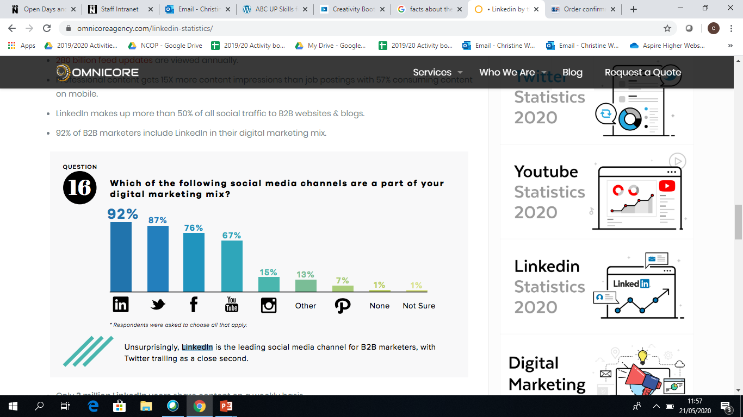
Why use ?
92% of companies use Linkedin as a part of their marketing
Linkedin is the top online site for professional use
95% of recruiters use Linkedin for recruitment purposes
Notes:
LinkedIn is a social media platform geared to professionals.
It enables you to network and to build your professional portfolio, but you can also go out into the world and look for an Apprenticeship, Internship, work experience, volunteering or a new job.
92% of companies use LinkedIn as a part of their marketing as it is geared towards professionals. Its worth remembering that 95% of recruiters used LinkedIn for recruitment purposes. This would not just to advertise positions but to see what experience you have,
Picture Source https://www.marion.com/using-linkedin-for-b2b-marketing/

Slide 8

Activity
Social Media Platforms
Think of 5 social media platforms and think of their prime purpose e.g. networking, socialising etc.
Now list those platforms in order of relevance to you, from the most to least used.
Notes:
5 minute task.
Ask students to think of 5 social media platforms and there prime purpose. Then list these platforms in order of relevance to them.
Discuss the students order and how their answer may of changed if they were asked the same question 2 years ago? How would their preference change in the next 2 years?

Slide 9
How to create a LinkedIn profile
Simple, just fill in a form?
Notes:
How to create a LinkedIn profile.
I’m guessing you are all thinking.
Simple just fill in a form?

Slide 10

Profile Headline
Marketing student seeking a social media internship
Health management student aspiring to be a leader in health
Ambitious student seeking marketing apprenticeship
Sales Management student, graduating in June 2020, seeking full-time position
Notes:
It’s your headline so make it relevant.
Try something like Ambitious student seeking marketing apprenticeship or 'Health management student aspiring to be a leader in health'. Get into more details in the summary, but make your first sentence pop. ...
Use industry-specific keywords., always write in a first-person perspective, and explain what you do now in the simplest way possible. And always break up your paragraphs, remember white spaces,
You can include information about your non-work life and keep it short and punchy.

Slide 11

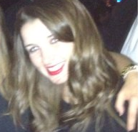

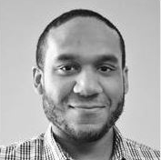
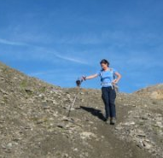
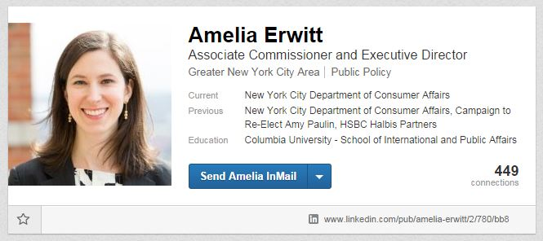
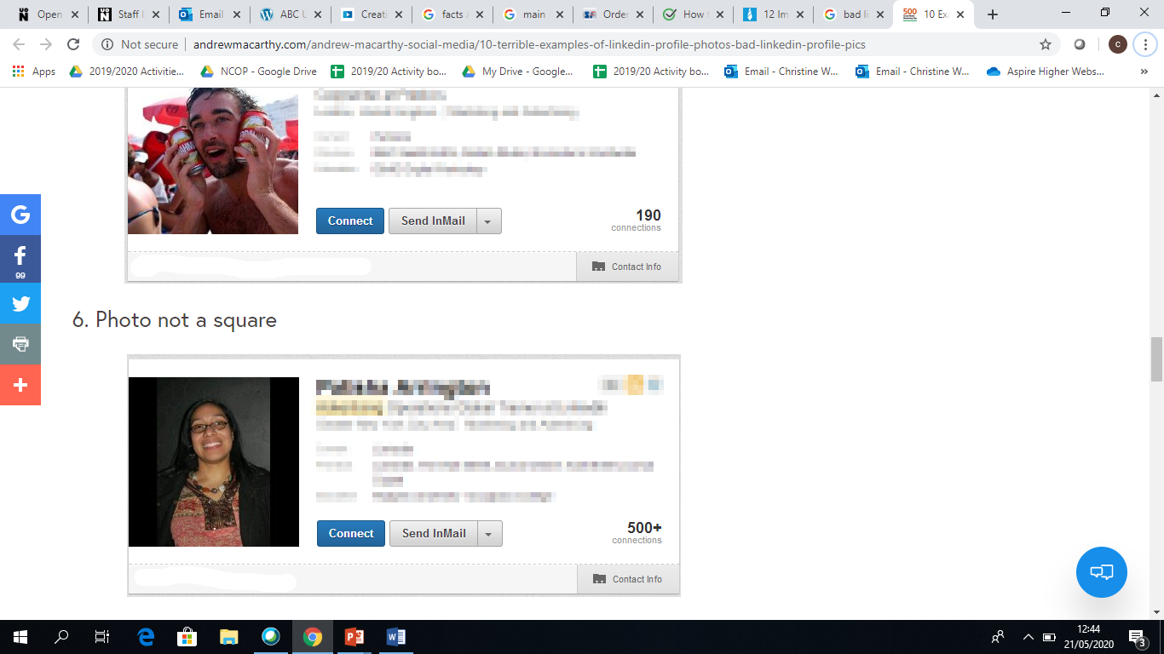
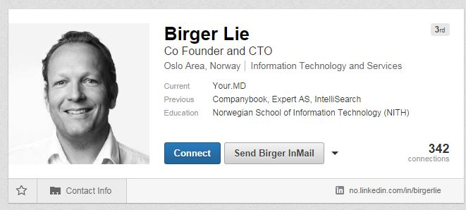
Photo
How should it look?
Notes:
A profile photo humanises your representation on the site, and will allow you to be recognised in real life. If your job title and summary are remarkable, if you're rocking the "empty profile photo" profile photo, then chances are people are not going to pay you any notice.
Ask a friend or relative to take the photo, keep it current, just a headshop, smile naturally and keep the background simple. Remember to dress for the occasion and go easy on the make up.
Edit your photo, crop and size, ensure you fill the space and don’t make it blurred. There are online programmes you can use for editing if you are unsure.
Don’t use a Cropped and blurry, a photo that’s proportions squeezed, subjects that are miles away or you can’t see the persons face… and make it professional.
Photo source https://www.andrewmacarthy.com/andrew-macarthy-social-media/linkedin-profile-photo-tips-examples
https://www.andrewmacarthy.com/andrew-macarthy-social-media/10-terrible-examples-of-linkedin-profile-photos-bad-linkedin-profile-pics

Slide 12

Education
Make sure you include everything!
Tell your professional story
Promote your highest academic level
List all relevant qualifications
Make yourself easy to find
Reconnect with colleagues
Notes:
Include all of your school education. Do not be shy.
List all qualifications – Include all qualifications, courses.
You should always list your highest qualification. Relevant or not. It does show at what academic level your thinking is (or at least once upon a time was).
Keywords, does that ring a bell?
What is your ideal client, employer or customer looking for?
They’ll use the search option in LinkedIn of Google, so your profile needs to be keyword rich.
What better way to tuck in some keywords than right at the bottom of your profile.
Reconnect to expand your network. LinkedIn is a network and in order to network, you need to be connected. It is easy to find people you studied with (and be found by them) if you list your education properly with the right institution, course and dates.
Start telling the story of the professional you are today! This is the beginning of your professional online presence.
Photo source https://www.playbuzz.com/nikitas19/8-31-2017-11-34-35-am

Slide 13
Develop a professional summary
Here are some top tips
Describe your accomplishments
Use white spaces
Write in the first person
Don’t make it too long
Proof read
Treat it like a cover letter
Include key words
Update your status regularly
Notes:
Your summary statement is like the first few paragraphs of your best written cover letter, concise and confident about your goals.
You should include relevant work experience and extra curricula activities.
Include key words and phrases that people search for examples are skilled, motivated, successful this way your profile will stand out more.
Update your status regularly, helps you stay on the recruiters radar and build a professional image. Talk about projects, professional books or events that you are attending.
Photo Source Company – LinkedIn

Slide 14

Get found and be noticed
Put yourself out there to others
Recommendations
Keep it professional
Share your work
Custom LinkedIn URL
Notes:
Recommendations make your profile genuine and personal. If you’ve worked with the recipient of the person asking for a recommendation and if you've known each other for a while, you know their personality as well.
Consider their Recipient's Goal. ...
Keep it Professional. ...
Keep it Short.
Start With a Knockout Line for example It’s rare that you come across standout talent like Mike.
Describe Your Relationship for example I had the pleasure of working with Jim for two years at Waitrose, working closely to provide an excellent service.”
Share a Standout Trait for example I was always in awe of Fred’s ability to command a room and get people on board with ideas—even people who were initially on completely different pages.
Add a Touch of Personality for example No matter how tense a meeting, Annie made sure everyone left with a smile.”
End With Your Solid Recommendation for example As a team member or a leader, Steve earns my highest recommendation
Don’t be afraid to ask people you know for recommendations…..just don’t ask people who are friends of friends (of friends!)
Another easy way of being found is to custom URL. You can have 5-30 letters or numbers. Don't use spaces, symbols, or special characters. Using a variation of your name and/or your professional brand since you'll share this URL with people so they can find your LinkedIn profile. It the same as principle as your email address, keep it professional.
Photo source: https://www.axonator.com/

Slide 15

Activity
Profile Headline
Now its your turn to write a profile headline remember to POP!
Top Tips:
Don’t use the summary Linkedin generates
Write in the first person
Short and simple
Use white space
Treat it like a cover letter
Include keywords
Describe your accomplishments
Proofread
Notes:
15 minutes activity in writing a profile headline.
Remember to make it POP.
Top Tips:
Don’t use the summary Linkedin generates
Write in the first person
Short and simple
Use white space
Treat it like a cover letter
Include keywords
Describe your accomplishments
Proofread

Slide 16
Why should students be on LinkedIn?
I’m too young for LinkedIn!
Notes:
Why should students be on LinkedIn.
Are you thinking I’m too young for LinkedIn?

Slide 17

Students on LinkedIn
It’s about networking!
Network
Network
Network
Notes:
You are not to young to begin to build your professional network. So Network, Network, Network.
Simply Linkedin is about your professional network. You never know when your professional paths will cross again. I’m sure you’ve all heard the phrase it’s a small world?
Start by linking to classmates. While they are friends and classmates now, in the future they become business referrals. Ask teachers who are on LinkedIn to write a recommendation for you. Linking to teachers ensure that you will stay connected to them after you finish you’re A-levels . This could be beneficial in your future career.
If you meet someone who interests or inspires you, do not be afraid to ask to connect with them on LinkedIn, For example I am sure you’ve all been to an inspiring talk or attended a careers event and was inspired by someone you met.
You can also used Linkedin to help decide your career path. Find people who are in LinkedIn who are already employed in your desired profession. Check out their profiles to see what they have done to become successful. See if you can incorporate something from their career path into yours.
Use it to prepare for interviews, this could be for University, an apprenticeship or a job. When you have a interview, review the profile of the person who will interview you. Having this background knowledge during the interview will help impress the interviewer. You will also see if you have any conmen links, people you may of worked of studied with.
Extend your CV . Many companies prefer receiving one-page cvs. That's not room for a lot of information. LinkedIn provides a place to have more in-depth information than what a short resume can ever hope to provide. Put your LinkedIn profile URL on your cv. Future employers can then find more information about you in LinkedIn. Linked in is often seen as an alternative to a CV.
Join a group. LinkedIn automatically shows you groups you may like to join based on the information in your profile. As a member of the group, you have access to thought leaders and experts in your industry. Read their posts to glean information about the industry and to gain their insights about current trends. Post thoughtful comments so group members can get to know you. Group connections are helpful when deciding your next step in your education and your career.
Photo source company LinkedIn

Slide 18

Activity
Create your profile
With the knowledge you have learnt today, go and make your very own
LinkedIn profile.
Notes:
Activity at home - create your profile.
With the knowledge you have learnt today, go and make your very own
LinkedIn profile
Photo source company linkedIn
Photo source https://www.dreamstime.com/stock-photos-connect-business-people-network-connections-image19433603#res29250703

Slide 19



Don’t forget to complete our survey!
Help us to help you!
Click here for survey
aspire-higher.co.uk/
@AspireHigherNet
Notes:
Help us to help you.
Please complete the survey.
Photo source https://www.eurodrying2019.com/uk/page.asp?PID=97
Company logo: Twitter

Slide 20
Social Media
Learning about LinkedIn

