Slide 1
Jobs of the Future
Notes:
Welcome to this workshop on “Jobs of the Future”

Slide 2
Want this resource in another format?
If you require this presentation with an audio voiceover and subtitles, click the link below.
Click Here for Jobs of the Future Presentation with Audio and Subtitles - No Activities
Help us to help you
Use the button to adjust subtitle options

Slide 3
Help us to help you!
Please complete the survey – it takes just 2 minutes!
It will help us support you more in the future!
Help us to help you
Click here for survey
Notes:
Help us to help you.
Please complete the survey – it takes just 2 minutes!
It will help us support you more in the future!
Picture source https://www.freepngimg.com/internet/feedback

Slide 4
Content of the session
How can we see that jobs are already evolving?
Where can you find reliable information about future jobs?
What is future proofing and how can it be evidenced?
Notes:
During the session today we will answer three big questions:
How can we see that jobs are already evolving?
Where can you find reliable information about future jobs?
What is future proofing and how can it be evidenced?

Slide 5
How can we see that jobs are already evolving?
The more reflective you are the more effective you are…
Notes:
The first question we will address is: How can we see that jobs are already evolving?
It is true to say that The more reflective you are the more effective you are.
In this instance it is important to reflect on what is happening in employment. Looking at the changes in jobs now will enable you to do this in the future. Following this practice will be prepare you for an evolving career path. For example, many employees 15 years ago may not have had their own computers or laptops to work from, now most people do as well as mobile phones and tablets.

Slide 6
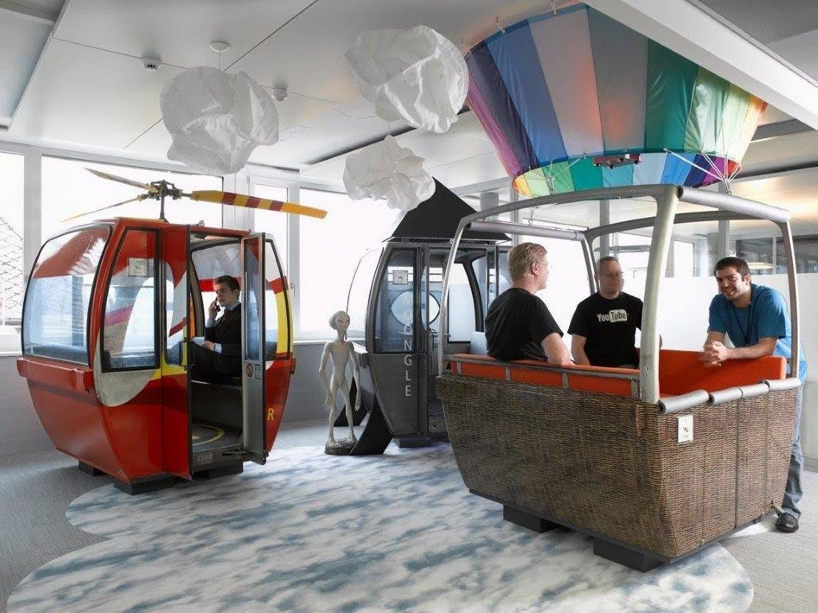
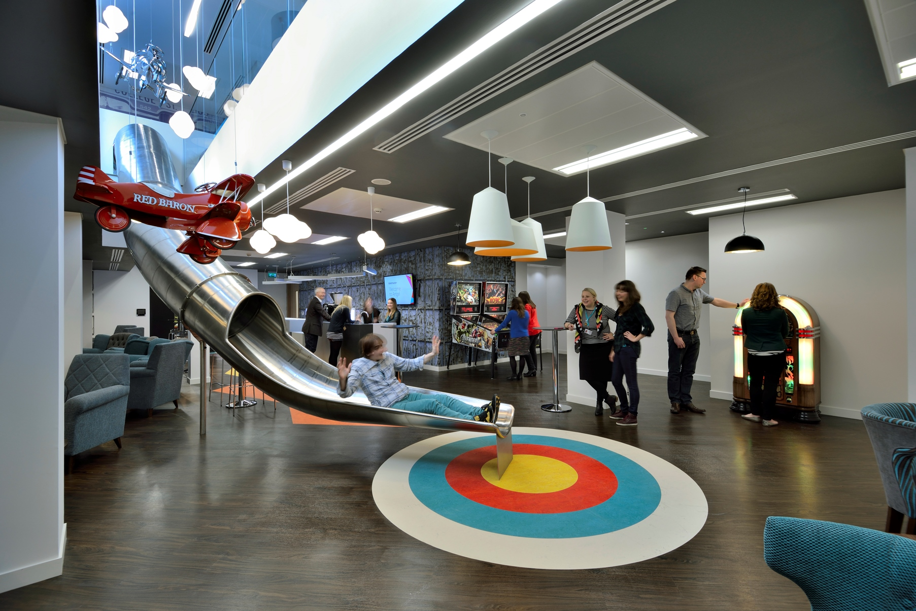
Employers and job roles move with the times and are ever changing.
Employers are creating spaces they feel are more productive and better for staff wellbeing.
Notes:
Employers and job roles move with the times and are ever changing.
It is not only job roles that are changing, so are working spaces. We can see that employers are adapting and starting to create spaces they feel are more productive and better for staff wellbeing such as live desks and possible working from home.
On the screen are 3 examples.
(Pictures from left to right)
Picture 1: Google Office (Zurich) Meetings and ideas are shared in an environment more recreational than professional.
Picture 2: Ticketmaster (London) Workers can have fun moving from one floor to another via a slide
Picture 3: Selgas Cano (Madrid) Workers can feel more connected to nature
Image 1 source: https://www.businessinsider.com/google-zurich-headquarters-tour-2018-1?r=US&IR=T
Image 2 source: https://discover.ticketmaster.co.uk/music/welcome-inside-ticketmaster-hq-3809/
Image 3 source: https://www.dezeen.com/2009/06/11/office-in-the-woods-by-selgascano/

Slide 7
Some jobs didn’t exist 10 years ago
Cloud Computing Specialist
Big Data Analyst
App Developer
App Designer
Uber Driver
Digital Marketing Specialist
Chief Listening Officer
Social Media Manager
Blogger
SEO Specialist
Notes:
There are also jobs which exist now that did not 10 years ago.
Five examples of these are:
Cloud Computing Specialist
Big Data Analysis
App Developer
Social Media Manager
Uber Driver
Image 1 source: https://www.crn.com/news/channel-programs/5-companies-that-came-to-win-this-week-june-28
Image 2 source: https://technoforte.co.in/blog/page/3/
Image 3 source: https://chandigarh.in.locan.to/ID_4093437940/Mobile-application-Development-Services-All-over-the-world.html
Image 4 source: https://codersera.com/blog/is-it-cheaper-or-more-expensive-to-hire-remote-developers/
Image 5 source: https://uxplanet.org/uber-redesign-concept-2019-3d8c430f6c29

Slide 8
Activity Try this short activity
Think of a difference between life now and when you were younger
Can teachers/staff name a job from now that was not around 10 years ago?
Notes:
Presenter- To share a difference between life now and when they were the age of the audience.
Teacher/ Staff Challenge- Can a teacher or staff member name a job that was not around 10/20 years ago?
If the task is being completed at home- Can you ask someone you know to list a job that was not around 10/20 years ago?
Image Source:http://www.pngpix.com/download/women-thinking-png-image

Slide 9
Where can you find reliable information about future jobs?
Fake news or facts?
Notes:
The second big question we are addressing today is: Where can you find reliable information about Future Jobs?
Fake news or fact? It is vital that the decisions you make are based on facts and not misleading information which has been created for the writers benefit or to sell a story.

Slide 10
Reliable Source 1 Pearson, Nesta and the Oxford Martin School created the report “Future of Skills Employment in 2030”
Research considered:
Automation
Globalisation
Population ageing
Urbanisation
Green economy
Findings: Jobs in 2030 will require different skills
Findings:
Lifelong learning will be essential
Link to Future Skills Welcome Video
Notes:
Reliable source 1 is research and a website created by Pearson's.
The research is called “Future of Skills Employment in 2030” and was created by Pearson, Nesta and the Oxford Martin School.
The research considered:
Automation
Globalisation
Population ageing
Urbanisation
Green economy
The findings of the research were:
-Most jobs that will exist in 2030 will require different skills.
-Automation will impact jobs by increasing efficiency and people will need to work alongside machines.
-This point highlights the need for human skills to be developed to get into a particular sector and for lifelong learning to maintain employment.

Slide 11
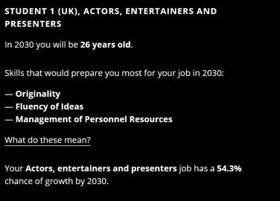
Activity What skills do you need?
Use the website below:
https://futureskills.pearson.com/
Enter your name, year of birth and job title
The results will show you the skills you will require for that job.
Notes:
Following the research by Pearson's they have created a tool, on the website address shown, to identify the skills for jobs of the future.
On the website you enter: the names, year of birth and job title.
On the right of the slide is an example.
I put the following information into the search engine.
Name: Student 1
D.O.B: 2004
Job: Actors, entertainers and presenter.
It has identified that the skills required ate:
- Originality
Fluency of Ideas
Management of Personnel Resources

Slide 12
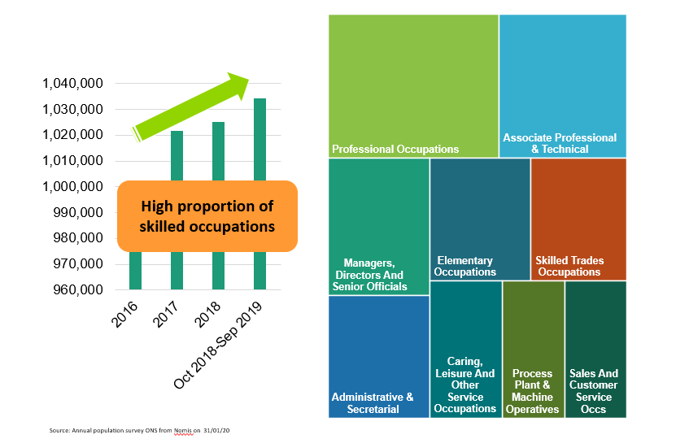
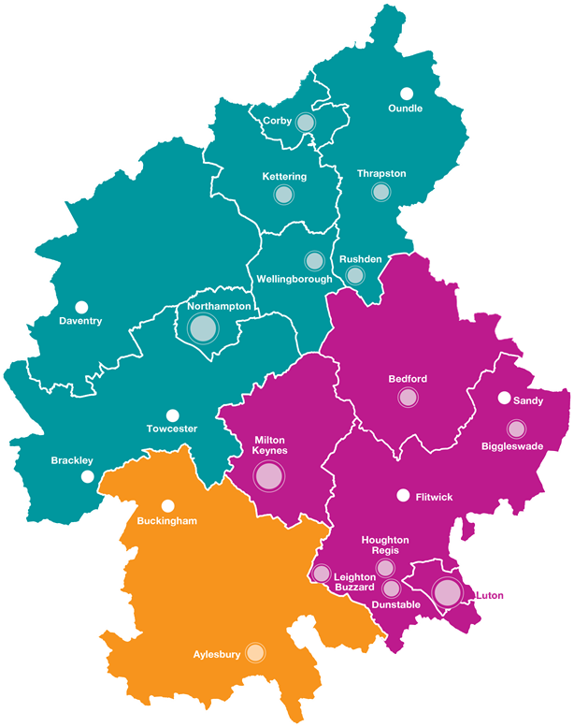
Reliable Source 2
Notes:
The second reliable source of information I would like to draw your attention to is South East Midlands Local Enterprise Partnership (SEMLEP)
SEMLEP creates easy to read Labour Market Information (LMI)
Image source: https://www.semlep.com/
SEMLEP Produce information such as this.
They look at the amount of jobs in an area. They also look at which areas/sectors are growing.
The information shown if for the South East Midlands.
A high proportion of the jobs are for skilled or semi skilled with only administrative and secretarial roles reducing.
Low skill elementary occupation numbers have remained fairly flat however the roles within those occupations have changed to include much more digital content taking on roles traditionally conducted by people in middle management/skilled area.
Image source https://www.semlep.com/

Slide 13
Employers Influences in Recruiting Young People
Notes:
SEMLEP have looked at what's important to employers.
It shows that the biggest influence in selecting a person for employment is their skills. Employers are looking for core competencies and transferrable skills such as adaptability, team work and being reflective. However, there is now a huge demand for basic digital skills – being able to utilise Microsoft Office and other digital skills such as programming. More detail on this shortly.
This research supports the findings of Pearson, Nesta and the Oxford Martin School, who said human skills are required for jobs of the future.
Image source: https://www.semlep.com/

Slide 14
What is Future Proofing and how can it be evidenced?
Skills, Skills, Skills!
Notes:
The final big question is: What is Future Proofing and how can it be evidenced?
The research from Pearson, Nesta and the Oxford Martin School and SEMELP is showing that skills are how you will future proof yourself for a chosen career.
I will introduce one type of skill and then it will be over to you.

Slide 15
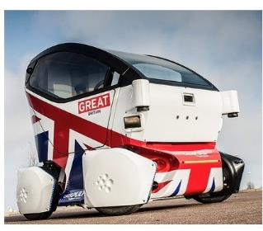
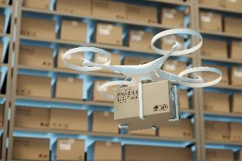
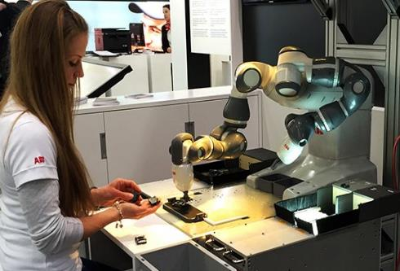
Spot Light on Digital Skills
The biggest impact on future skills is digital!
Robotics and automation
Autonomous vehicles and intelligent mobility
Delivery bots and drones
Notes:
I have drawn your attention to digital skills because SEMLEP have been alerted to the skills gap for digital technology.
There is job growth in:
- Robotics and automation
Autonomous vehicles and intelligent mobility
Delivery bots and drones
Image 1 source: https://www.abb-conversations.com/2015/04/introducing-yumi-the-worlds-first-truly-collaborative-robot/
Image 2 source: http://www.guilsborough.northants.sch.uk/for-parents/key-information/careers/careers-documents/1853-growing-people-south-east-midlands-labour-market-information/file
Image 3 source: https://techhq.com/2019/06/transport-management-for-the-rest-of-us-ratelinx-and-technology-in-the-mix/

Slide 16
Digital Skills List Digital skills can be split into 3 areas:
1. Basic Digital Skills
Basic online activities (emails, searching for information, banking, etc.)
2. Digital Literacy
Use of spreadsheets, word processing and presentation software, along with personal and business data protection.
3. Specialist Digital Skills.
Relate to specific digital jobs Hardware/Infrastructure support in roles such as:
Programming, Data analysis, Digital design, Digital marketing, Cyber security
Notes:
Digital Skills can be considered in 3 areas:
Basic digital skills
Basic online activities (emails, searching for information, banking, etc.)
2. Digital Literacy
Use of spreadsheets, word processing and presentation software, along with personal and business data protection
3. Specialist digital skills
Relate to specific digital jobs Hardware/Infrastructure support
Programming
Development and Information Technology Operations (DevOps)
Hardware/Infrastructure support
Data analysis
Digital design
Digital marketing
Cyber security

Slide 17
Activity Skills, skills, skills!
Research from Pearson, Nesta and the Oxford Martin School and SEMELP is showing that skills are how you will future proof yourself for a chosen career.
Task:
Call out a skills that you think employers will be looking for.
Notes:
Face to Face – place skills under seats. Students will find a piece of paper, each piece of paper will have a skill on it.
Virtual – ask students to consider a list of key skills
A full list is given on the next slide.
Image Source: http://psychologyformarketers.com/12-ways-to-build-self-confidence/

Slide 18
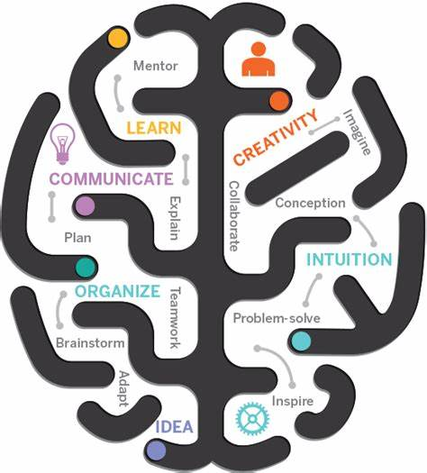
So many skills
SEMLEP found Employers are looking for the following skills
Core Competencies
Technical/
Vocational Skills
Attitudes & Behaviours
Basic Skills
Notes:
This is a full list of skills and core competencies.
Core Competencies: Communication, problem solving, resilience, initiative, organisation, Teamwork/Collaboration, Digital literacy, Creativity
Attitudes & Behaviours:
Work ethic, Curiosity, Independence, Reflective/Attention to Detail, Honesty, Reliability, Politeness, Humility
Technical/Vocational Skills
Job specific
Technical and practical
Specialist digital skills
Customer relationships/sales
Basic Skills:
Numeracy
Literacy
Basic Digital
Image Source : https://bankkita.com/explore/organization-clipart-transferable-skill/

Slide 19
Evidencing Skills
You can gain and improve core competencies from doing some, or all, of the activities shown.
Part-Time Job
Work Experience
Enterprise Activities
Employer Engagement
National Citizen Service
Cadets
School Activities
Use of IT
Volunteering
Sports
Duke of Edinburgh
Clubs and Societies
Notes:
You can gain and improve digital skills and all the core competencies we have looked at from doing some, or all, of the activities shown.
-Part-Time Job
- National Citizen Service
- Volunteering
- Work Experience
- Cadets
- Sports
- Enterprise Activities
- School Activities
- Duke of Edinburgh
- Employer Engagement
Use of IT
Clubs and Societies

Slide 20
Follow up Activity
Choose 1 skill and 1 digital skill, consider what experience you are going to get to evidence these in preparation for your future career.
Notes:
This is the follow up Activity.
Choose 1 skill and 1 digital skill, consider what experience you are going to get to evidence these in preparation for your future career.
Image source: https://confidentqueen.wordpress.com/2018/05/07/i-did-it-completed-6-weeks-fitnesschallenge-fittergenny/

Slide 21
In Summary
Jobs are ever evolving and changing.
You can prepare by increasing your skills/core competencies and evidencing these.
Digital skills are having an increasing impact on the majority of job roles and careers.
It is essential to be digitally competent in order to maximize your employability for the future.
Notes:
In summary
-Jobs are ever evolving and changing.
-You can prepare by increasing your skills/core competencies and evidencing these.
-Digital skills are having an increasing impact on the majority of job roles and careers. It is therefore essential to be digitally competent in order to maximize your employability for the future.

Slide 22
Don’t forget to complete our survey!
Help us to help you!
Click here for survey
aspire-higher.co.uk/
@AspireHigherNet
Notes:
Help us to help you.
Please complete the survey.
Photo source https://www.eurodrying2019.com/uk/page.asp?PID=97
Company logo: Twitter

Slide 23
Jobs of the Future
Notes:
Thank you for attending the workshop “Jobs of the Future”

