Slide 1
Resilience for Students DNA –V Approach

Slide 2
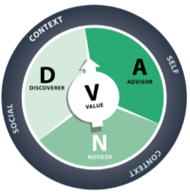
DNA-V – A wellbeing approach for secondary schools
The purpose of DNA-V is to help young people develop values and live with vitality. The discoverer, noticer and advisor provide the means to engage in valued action, supporting the values that lie at the centre of the model.
Values can be thought of as a compass that guides people through the storms and confusing times of life and towards the things they care about.

Slide 3
Outline of the sessions
These sessions have been created for you that you can teach your students over 4 lessons (1 hour each).
The idea is that you teach this approach to students, but they can go away and practice this form of wellbeing themselves at home.
You can either teach this to students directly at the school who are still attending school during the crisis, or you can adapt these lessons to suit them and teach this online.

Slide 4
Lesson 1
Start these discussions with your students:
1. What is it that makes us feel better e.g. good sleep, healthy food &
letting go of
your worries.
2. Who is your advisor: do you have a super hero that can support you
during times of trouble?
3. Discuss your short term and long term goals.

Slide 5
Lesson 1 continued
Now is a good time, for your students to try out the DNA-V approach.
1. Ask the student to stand up.
2. What is it that they are concerned about e.g. studying at home for a prolonged period of time.
3. Now go through each part of the DNA-V as shown on the next slide.

Slide 6
Lesson 1 continued
Ask the students to talk about the Noticer, Advisor and Discoverer as shown below:
Noticer = what is it you notice inside and around yourself?
Advisor = what advice are you giving yourself about things that are happening.
Discoverer = what do I do, test, try and track in the world?

Slide 7
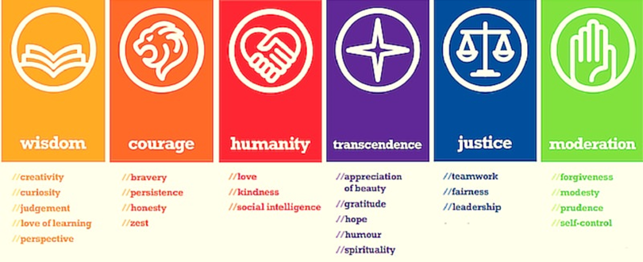
Lesson 1: Homework Discover your character strengths
Can you guess in advance what will be your top 3 character strengths and why?
Then discover your character strengths by taking this quiz: https://www.viacharacter.org/survey/account/register#youth
Bring your results with you to the next lesson!

Slide 8
Lesson 2: Playing a game & being creative
1. Share your homework – what are the results of your quiz?
2. DNA - V game of life – refer to next slide for the
Game of Life
3. Design a poster of your character strengths

Slide 9
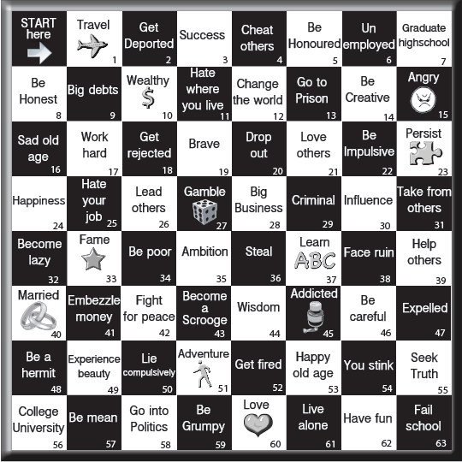
Lesson 2: GAME OF LIFE
Minimum of 2 people to play
You can use counters (every
day objects such as a button
or a coin)
1 Dice

Slide 10
Lesson 2: GAME OF LIFE
Instructions
Roll the dice, move however many steps forward. When you land on the place you need to be on, you must decide to keep or throw.
If you are keeping the comment, then you need to use the DNA - V model to explain why you would want to keep it (it might be handy to have your values written down in front of them for reference), this doesn’t need to be too in depth as when keeping something it is most likely positive.
If you want to throw the comment away, you need to do the same. Notice what would happen if you were to keep this comment, advise yourself what to do with this comment, discover what your options are and explain why it does not fit your values. If the reasoning is valid enough then you may throw the comment away.

Slide 11
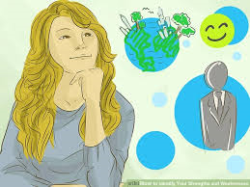
Lesson 2: Design a poster of your
character strengths

Slide 12
Lesson 2: Homework Feedback on the Game of Life
Would you change this game and have different categories in the game to choose from? Please explain your answer.
Bring your answers with you to the next lesson!

Slide 13
Lesson 3 – Studying at home
Today we will be using the DNA-V approach and how this can be used to keep you motivated and calm with your studies. To remind you of what the DNA-V approach is:
Noticer = what is it you notice inside and around yourself?
Advisor = what advice are you giving yourself about things that are happening.
Discoverer = what do I do, test, try and track in the world?

Slide 14
Lesson 3 – Acting still
Create a still image of yourself of how you feel about studying at home - you can either physically perform this or draw a picture of it.
Now use the DNA-V approach of your feelings around this.
Now repeat the still image to show how you feel after completing the DNA-V approach.

Slide 15
Lesson 3 – Discussion around support
What practical resources are out there to support you with your studying?
What can help you to stay calm?
Are you aware of any wellbeing apps e.g. Headspace.

Slide 16
Lesson 3: Homework
Research wellbeing apps that can support you – from the local community and also national apps.
Please bring this with you to your next lesson.

Slide 17
Lesson 4: Overview of what you have learnt
Discuss these with your students:
2. What matters to you? What’s important to you?
1. Share your long and short term goals.
3. What have you learnt from the DNA-V approach and what will you take from it?

Slide 18
Lesson 4: Youth Advisory Panel
Is there anything you feel that Aspire Higher can support you with at the moment
with your learning? You can complete these blank boxes with your ideas!

Slide 19
Thank you for listening.
Please click here to tell us what you think
aspire-higher.co.uk
Notes:
Thank you for listening. Please visit our website for more useful links and resources. If you have a question you can contact us via our Twitter handle. Please click on ‘Tell us what you think’ to answer a short survey. The information you give will help us to support students and develop more resources.

