Slide 1
Engineering Careers

Slide 2
Content of the session
What are engineering careers?
What skills are needed?
What qualifications do you need?

Slide 3
What are engineering careers?
It’s not just nuts and bolts

Slide 4
Invest in your future
Now is a great time to learn about Engineering Careers.
It is predicted these jobs will grow twice as fast as other careers.

Slide 5
Here are a range of engineering careers
Automotive Engineer Aeronautical Engineer Subsea Engineer
Structural Engineer Marine Engineer Motorsport Engineer
Chemical Engineer Aerospace Engineer Nuclear Engineer
Mining Engineer Data Engineer Construction Engineer
Tooling Engineer Test Engineer Technical Engineer
Aerosystems Engineer Development Engineer Mechanical Engineer
Completions Engineer Civil Engineer Computer Engineer

Slide 6
Activity 1- Were there any engineer careers you hadn’t heard of?
Get into pairs.
Choose 2 engineer careers from the list on the last slide.
Work in pairs to look online to find out more about these careers.
Look on: https://nationalcareers.service.gov.uk/explore-careers
Or on: https://www.prospects.ac.uk/job-profiles/
Any surprises?
Discuss what you found with your partner.

Slide 7
What skills do you need?

Slide 8
An example of how skills link to work

Slide 9
Activity 2- What skills do you have?
Everyone has skills.
Think of what you do in and outside of school.
Write down 3 skills you think you have on a piece of paper.
Here are some examples:
Music, dance and drama – creative thinking, team work.
Sports team – communication, decision making, team work.
Young leaders – team work, orienteering.
Other skills include : computing, languages, problem-solving, time management and adaptability.
All of these skills are useful for careers in engineering

Slide 10
What qualifications do you need?

Slide 11
What could my next steps be?
After your GCSEs in Year 11 you can:
Continue your education either at sixth form or college through studying A Levels, T-Levels, BTECs, etc.
Learn through an Apprenticeship or other work-based learning programme to gain vocational qualifications.

Slide 12
Exploring this in practice
What can I do with 5 or more GCSEs grade 4+
What can I do with less than 5 GCSE passes
A-Levels
T-Levels
BTEC Level 3
BTEC Level 1 and 2
Level 3 Apprenticeships
Level 2 Apprenticeships
*There may be other qualifications available to you not listed above.

Slide 13
Flexible Education Pathways
A Levels
GCSE’s
University Degree
T-levels
BTEC Level 3
Career
GCSE’s/ BTEC Level 2
Higher/Degree Apprenticeship
Apprenticeship Work, Training

Slide 14
Job levels and qualifications
Trainee Technicians – 4 or more GCSEs grade 4 to 9.
Technician - Level 3 qualifications such as A-levels, BTEC diploma or equivalent.
Engineers – A foundation degree, HNC, HND or degree in a relevant subject.
Chartered Engineers – Require further learning usually a Masters in Engineering.

Slide 15
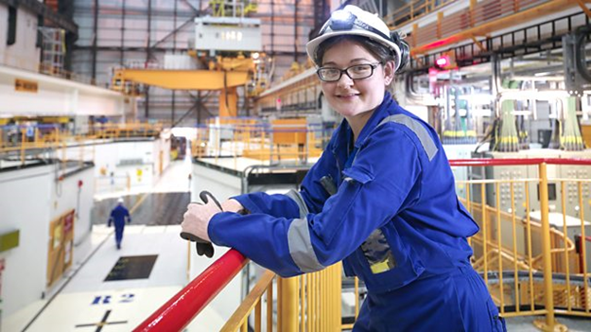
Engineering is for everyone
Women work in all sectors of engineering.
As reported in March 2022 by Engineering UK:
Women make up 16.5% of all engineers,
compared to 10.5% reported in 2010.
The actual number of women working in
engineering roles also increased from 562,000 in 2010 to 936,000 in 2021
*https://www.wes.org.uk/

Slide 16
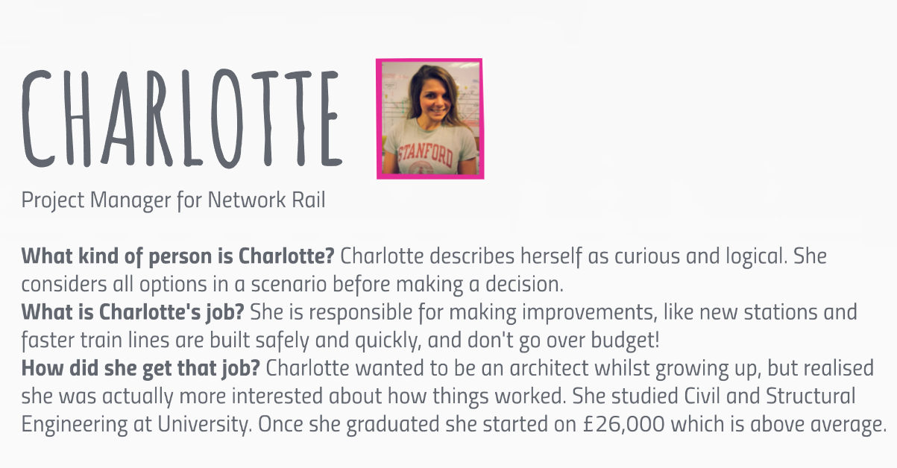
Case Study 1
Notes:
Charlotte is an example of someone who studied a degree at university to get into an engineering career. Look at Charlotte’s story to find out more about the skills she has, her job and how she got into her career. She even says what she started earning as a salary.

Slide 17
Case Study 2
Notes:
Gemma got into a career in engineering without a degree. She started with an apprenticeship in engineering. You can decide the route you want to choose. Look at the details above to find out more about what Gemma does, her skills and her route in. She also says how much she earns.

Slide 18
Qualification routes into Engineering
GCSEs
Maths
Sciences
Technology
A-levels
Maths
Engineering
Degree
Engineering
BTEC
T-levels apprenticeship
Sciences
Engineering
Masters
Notes:
If you are considering a career in STEM you need to study specific subjects. You study Maths and Sciences as part of your GCSEs. To continue into a job in STEM you may want to consider studying a science subject and Maths at A-level. A few sixth forms also offer engineering at A-level. The new T-levels and level 3 BTEC diplomas and apprenticeships also offer engineering as a subject. There are routes into STEM careers with or without a degree. There are some advantages of studying a degree for professional careers.

Slide 19
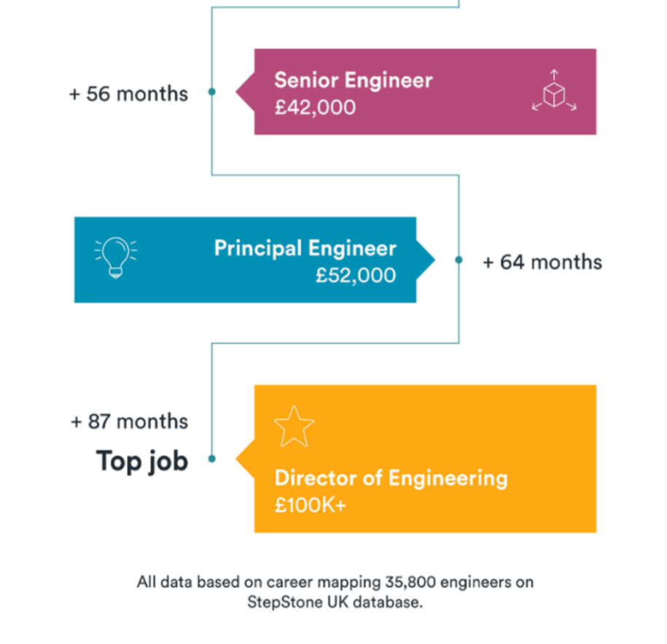
Leading to a future in…

Slide 20
Useful websites to find out more:
www.engineeringuk.com
www.wes.org.uk
www.work.chron.com
www.educatingengineers.com
www.eeegr.com
www.theengineer.co.uk
www.gardline.com
www.tomorrowsengineers.org.uk
www.engineersuk.com
www.engc.org.uk
www.soe.org.uk
www.bema.co.uk
www.theiet.org

Slide 21
Thank you.
Please click here to tell us what you think
aspire-higher.co.uk
Notes:
Thank you for listening. Please visit our website for more useful links and resources. If you have a question you can contact us via our Twitter handle. Please click on ‘Tell us what you think’ to answer a short survey. The information you give will help us to support students and develop more resources.

